Slide 1

汙水處理一水資源控管
Water Treatment Plant
國立臺北大學 統計學系四年級
劉又瑄 藍雍淵 蔡岱融

Slide 2



研究動機
>
>
人口急遽上升
汙水增加
汙水處理
>
>

Slide 3
Introduction

Slide 4


汙水處理流程
初步處理
一級處理
二級處理
>
>
>
>
X 塑膠袋
X 鐵鋁罐
X 懸浮固體
X 有機汙染物

Slide 5
Data

Slide 6

資料背景
西班牙 巴塞隆納
527 個紀錄
38 個水質指標
2.9% 遺失值
 | Q_E | ZN_E | PH_E | … | RD_SED_G
1990-01-01 | 41230 | 0.35 | 7.6 |  | 99.4
1990-01-02 | 7386 | 1.40 | 7.9 |  | 100
1990-01-03 | 34535 | 1.00 | 7.8 |  | 99.8
:
1991-10-30 | 1524.0 | 1.60 | 7.9 |  | 99.2

Slide 7
變數說明
水質指標 |  | 流入水質狀況
Q- 水流(L/hr) ZN-鋅含量 PH-酸鹼值 COND-導電度 | DBO-生化需氧量 DQO-化學需氧量 SS-懸浮固體 SSV-揮發性懸浮固體 SED-沉積物 | Normal (正常) Normal_Low_Influent (流入量少) Normal_over_Mean (較乾淨) Settler_Problem (處理器故障) Solid_Overload (固體超標) Storm (豪雨)

Slide 8


變數說明
E
P
D
S
Q
ZN
DBO
DQO
SS
SSV
SED
初步處理
PH
COND
DBO
DQO
SS
SSV
SED
一級處理
PH
COND
DBO
DQO
SS
SSV
SED
二級處理
PH
COND
DBO
DQO
SS
SSV
SED
PH
COND
Input
Input to
primary settler
Input to secondary settler
Output

Slide 9
分析流程
Raw Data
Exploratory Data Analysis (EDA)
Missing Value
Dimension Reduction
PCA
ISOMAP
DR Quality Assessment: LCMC
Clustering
Hierarcical Clustering
Validation: Internal, Stability

Slide 10
Exploratory Data Analysis (EDA)

Slide 11
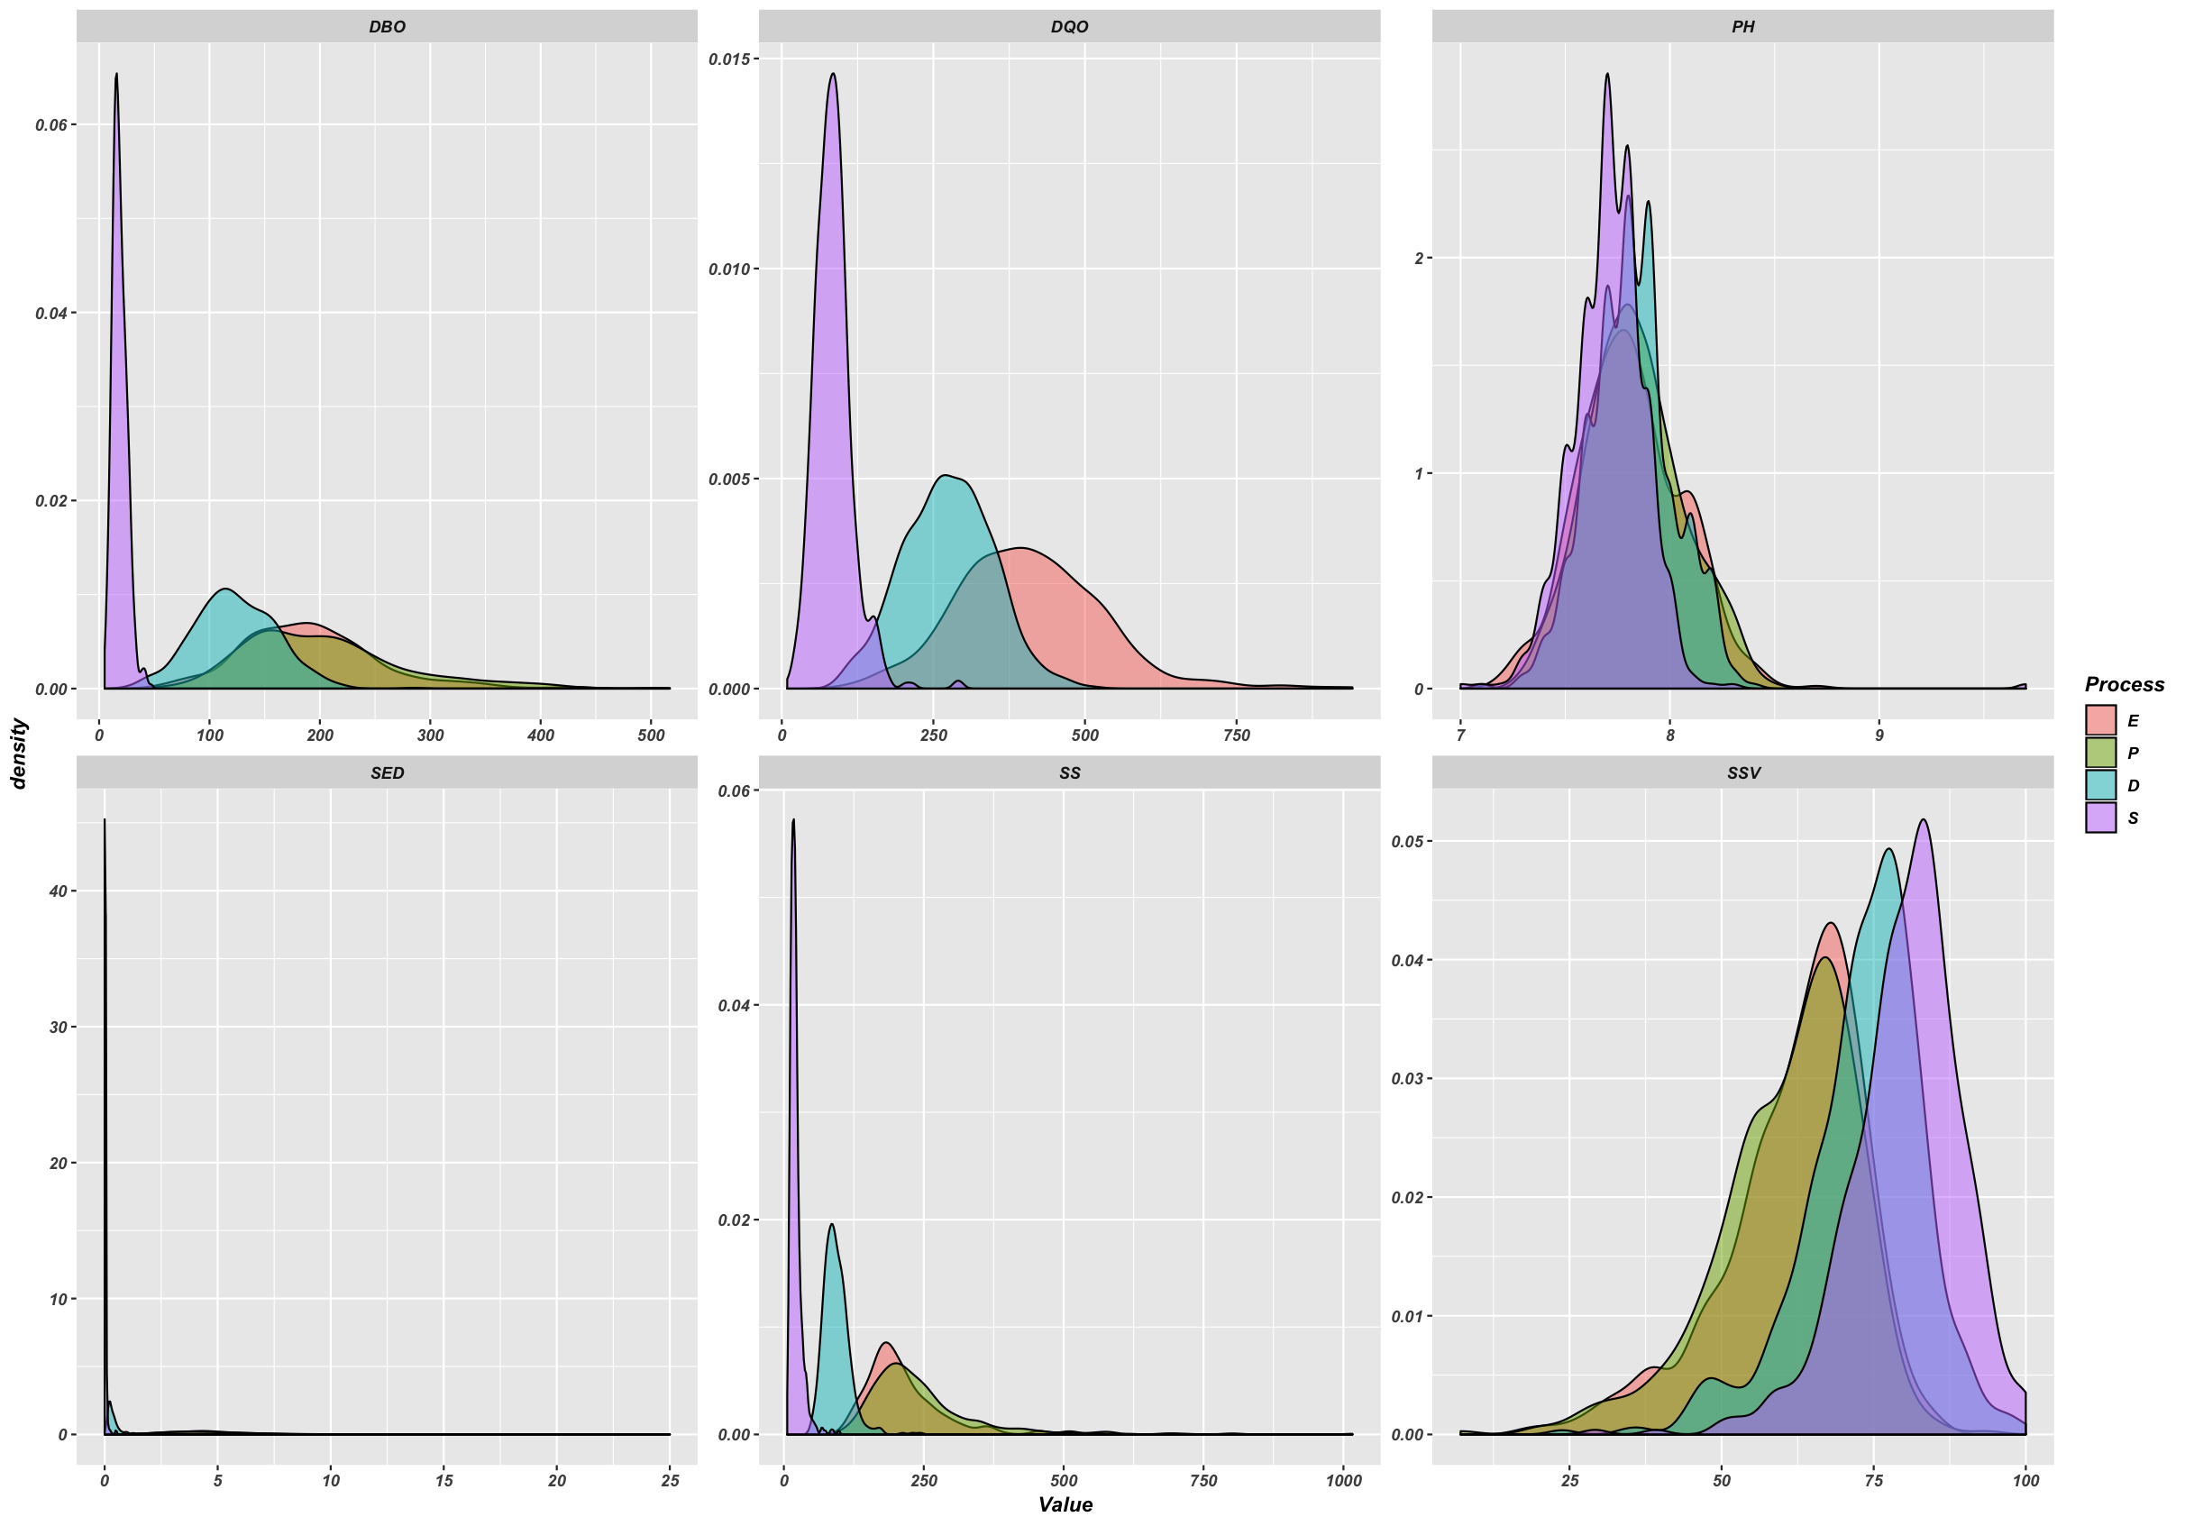
Kernel Density Estimation

Slide 12
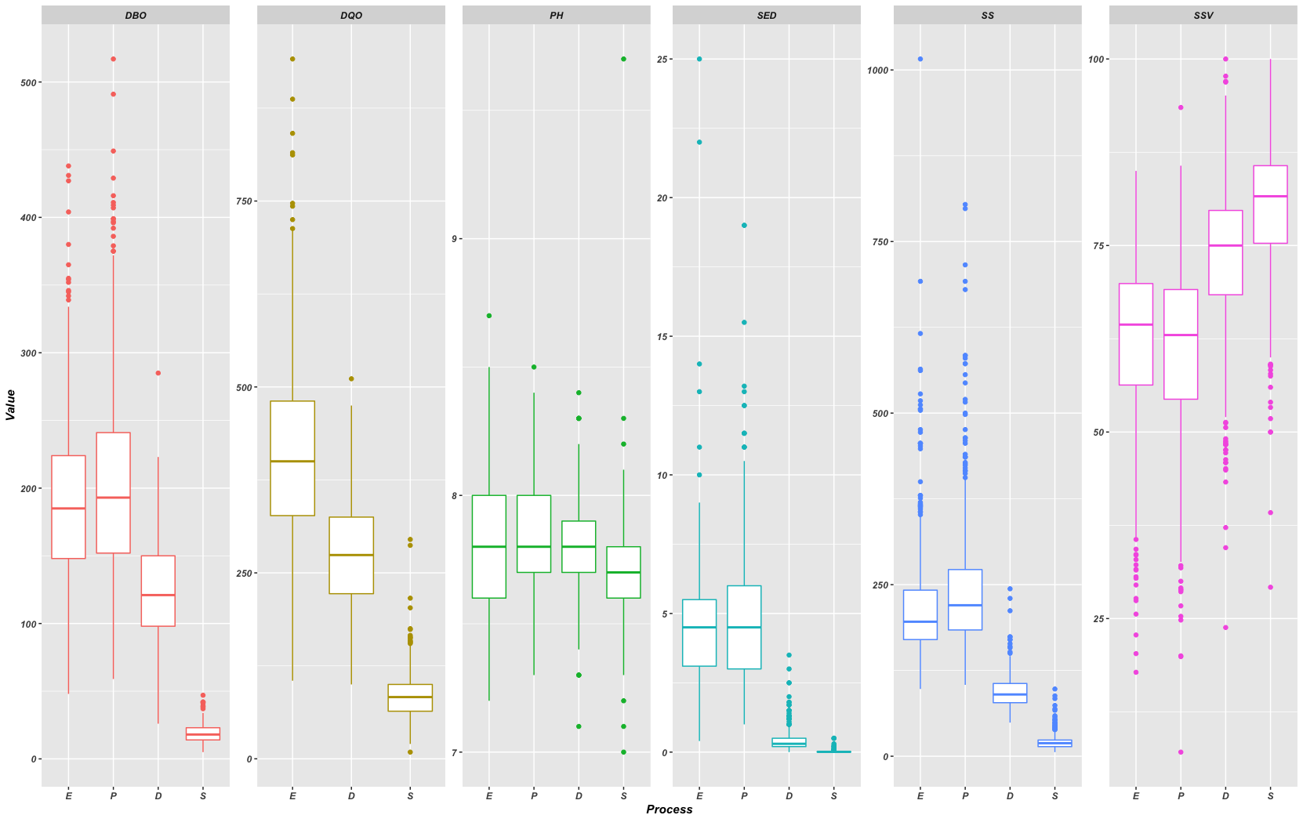
Boxplot

Slide 13
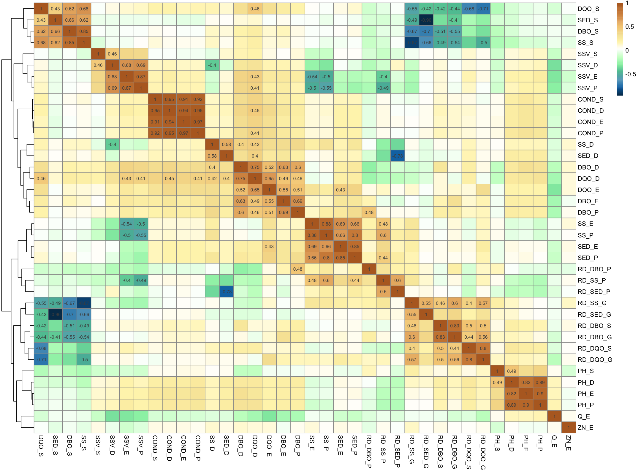
Correlation Coefficient

Slide 14
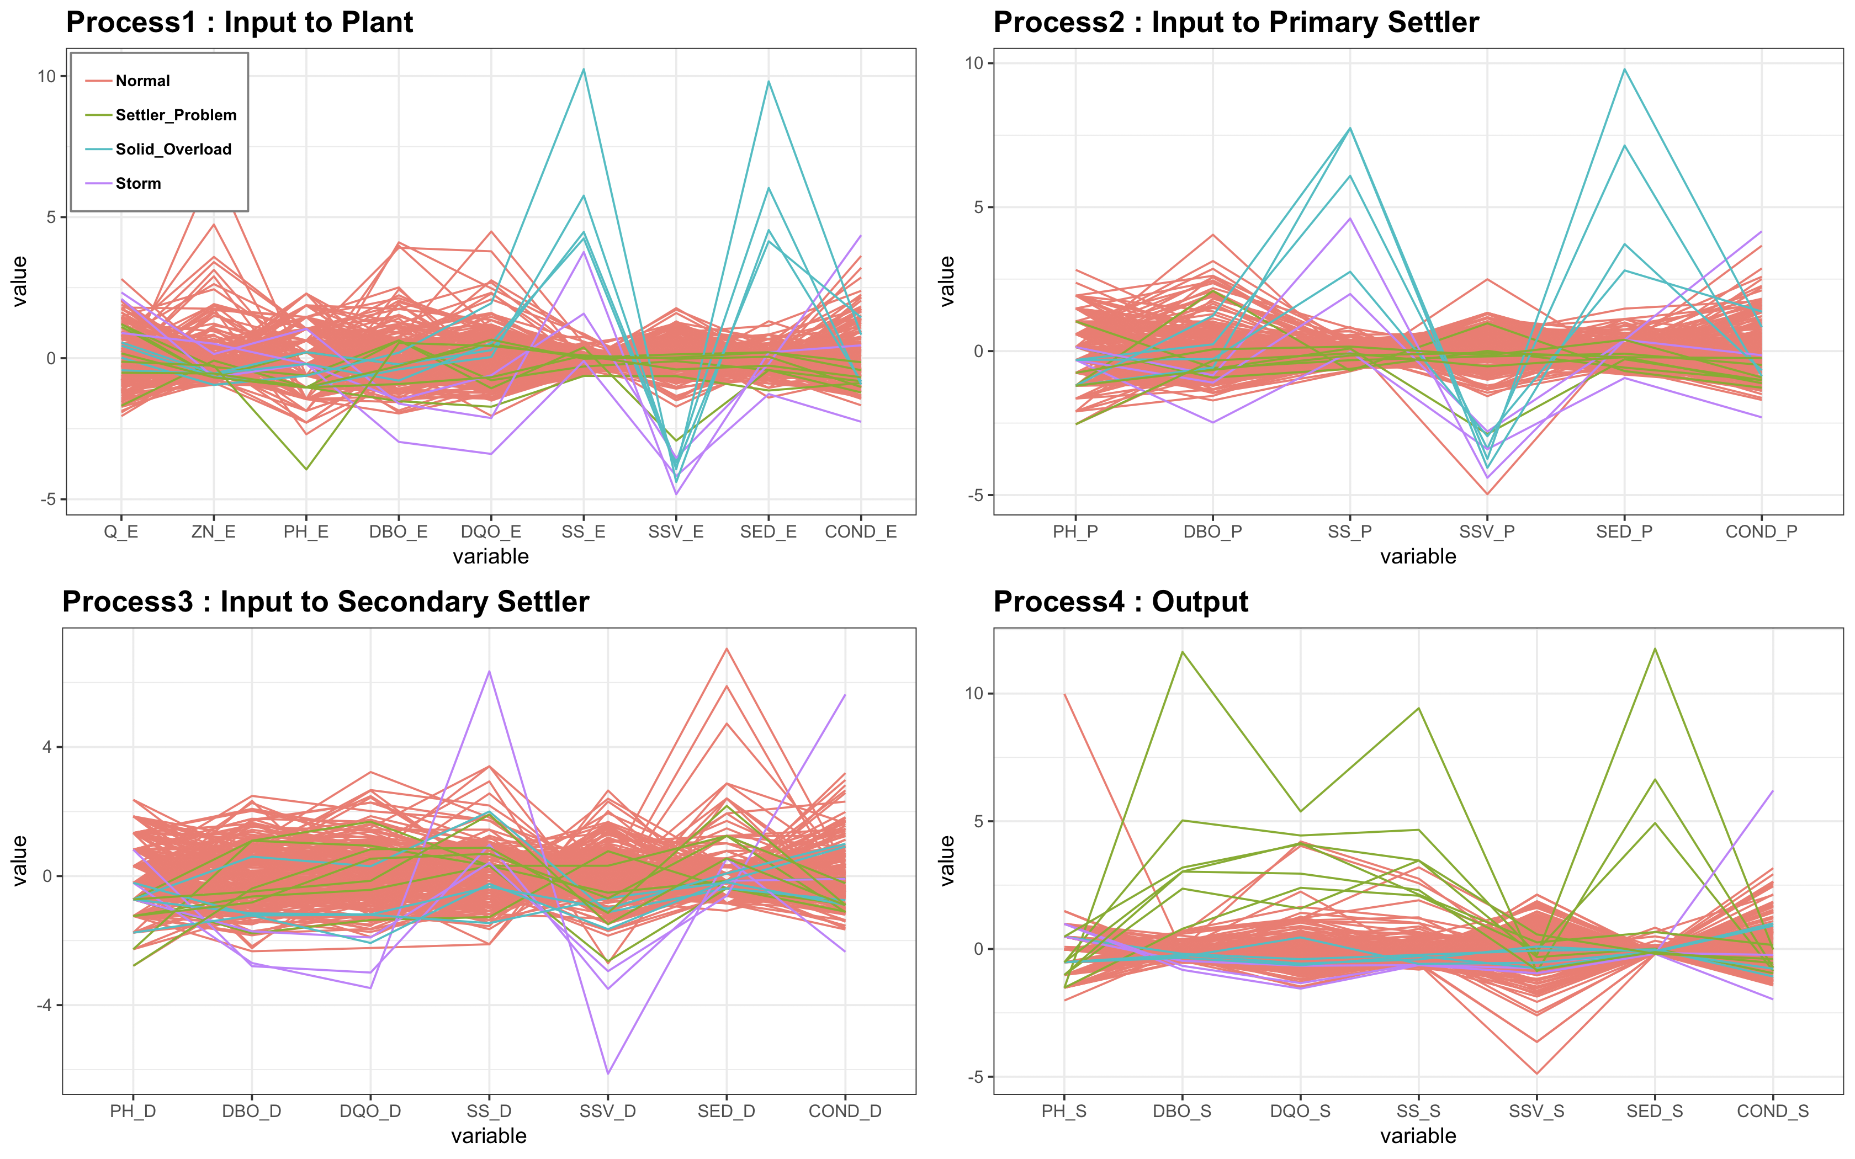
Parallel coordinates

Slide 15
Missing Values

Slide 16
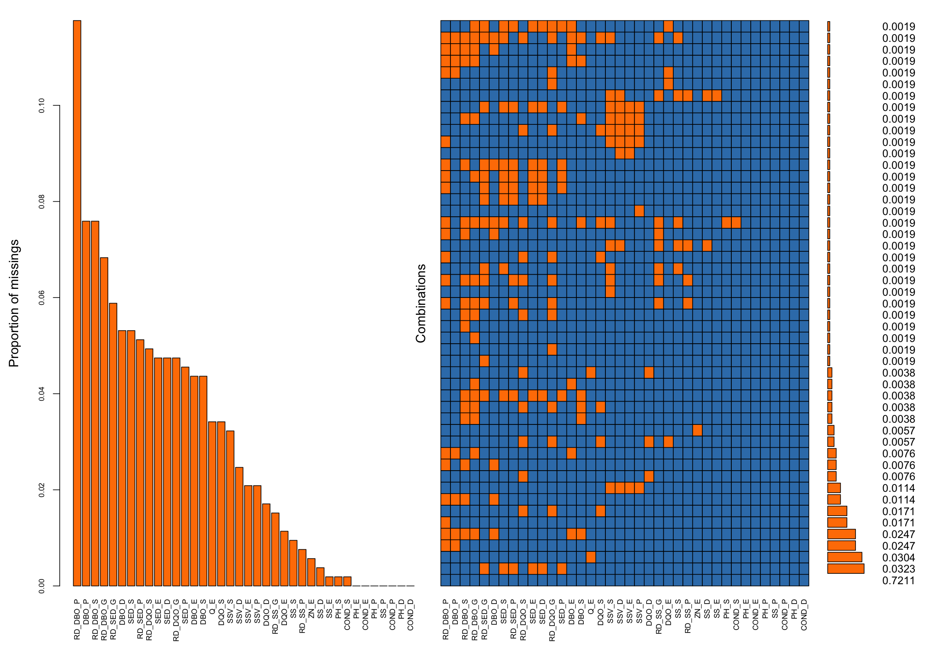
Aggregations for Missing Values

Slide 17
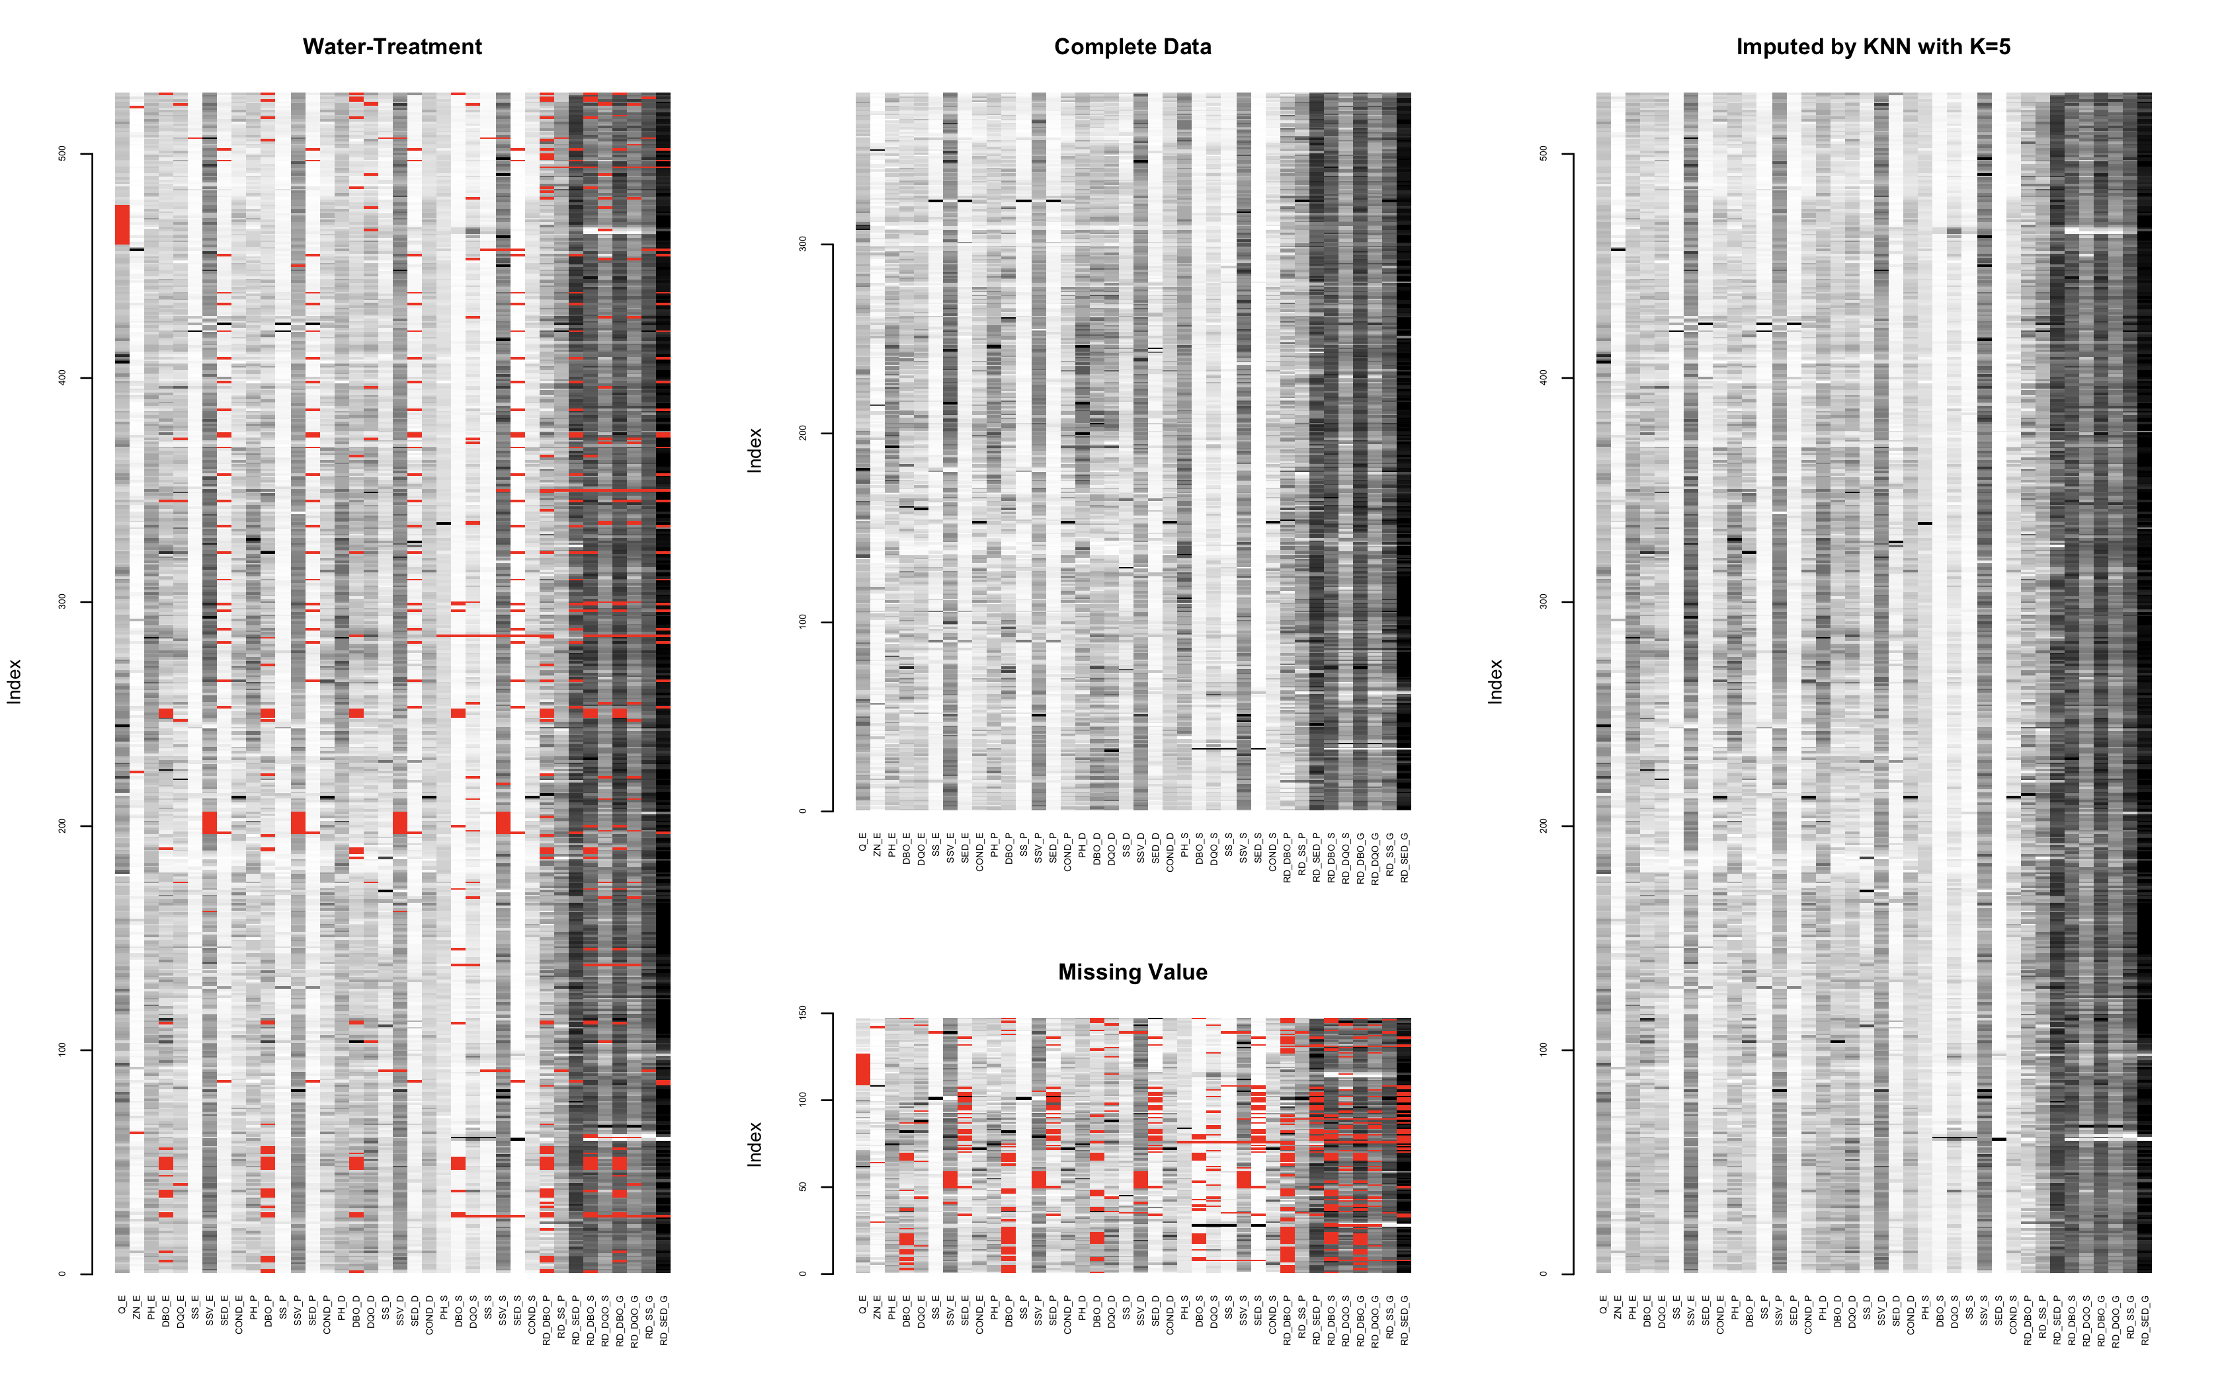
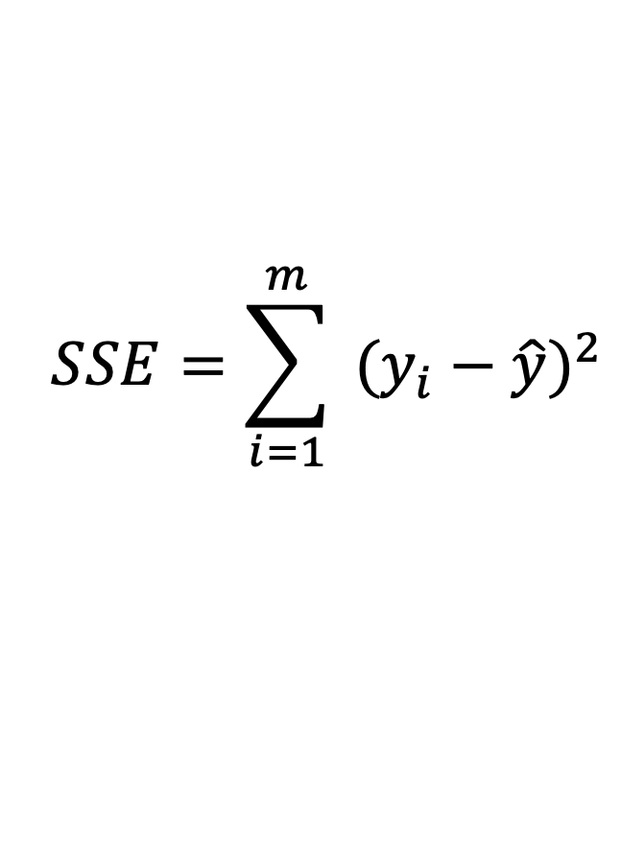
Imputation
$$SSE=\sum_{i=1}^{m}{ {(y_{i}−\hat{y})}^{2}}$$

Slide 18
Sum of Squared Errors (SSE)
SSE | K = 1 | K = 2 | K = 3 | K = 4 | K = 5
KNN.Mean | 492046088 | 373429193 | 334394506 | 277017945 | 160405219
KNN.Median | 492046088 | 373429193 | 265637655 | 257449712 | 259266191
KNN.Trimmean | 492046088 | 373429193 | 334394506 | 277017945 | 217761130
SSE | K = 6 | K = 7 | K = 8 | K = 9 | K = 10
KNN.Mean | 172719942 | 185245075 | 189605331 | 197136518 | 217799651
KNN.Median | 246303899 | 250485818 | 252480125 | 248698266 | 248827966
KNN.Trimmean | 225358420 | 236814124 | 234058962 | 233648223 | 256569715
SSE | mean | pmm | norm
mice | 210895406 | 642006914 | 429817930
Minimum SSE | K=5
KNN.Mean | 160405219

Slide 19
Dimension Reduction
Data Set : n>>p (527x38)

Slide 20
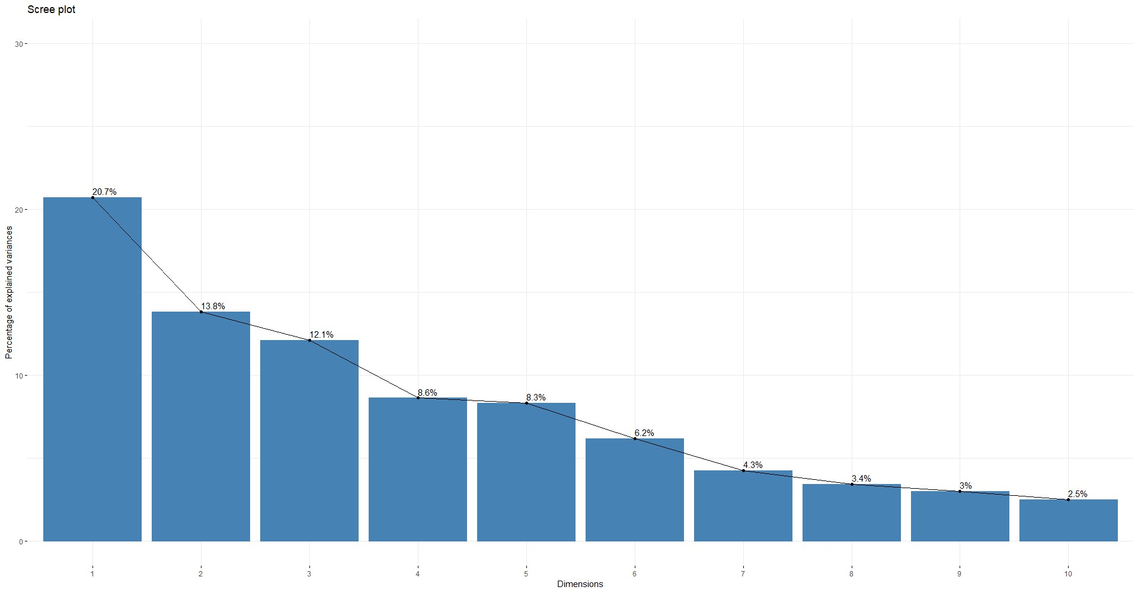
Principal Components Analysis

Slide 21
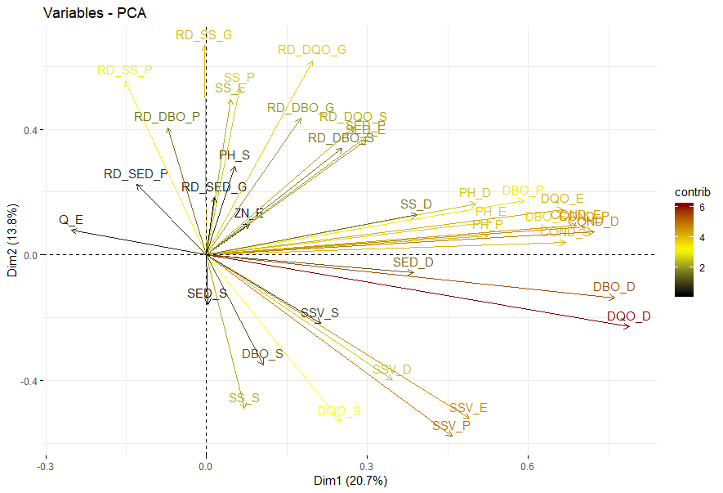
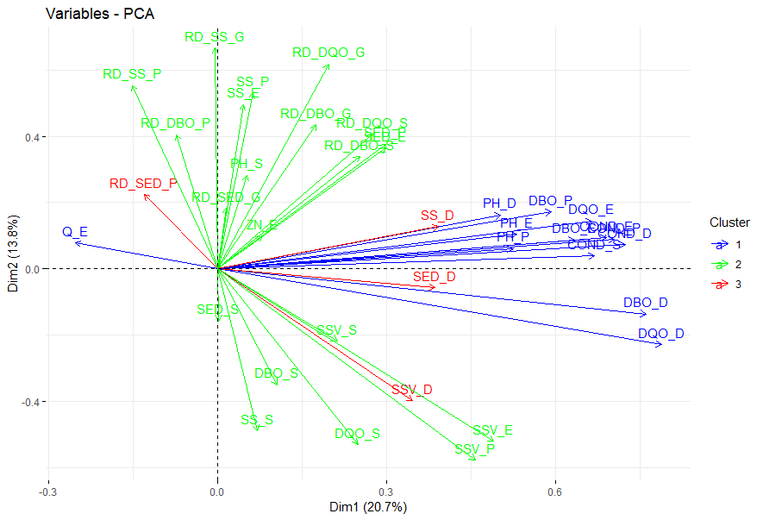
Principal Components Analysis

Slide 22
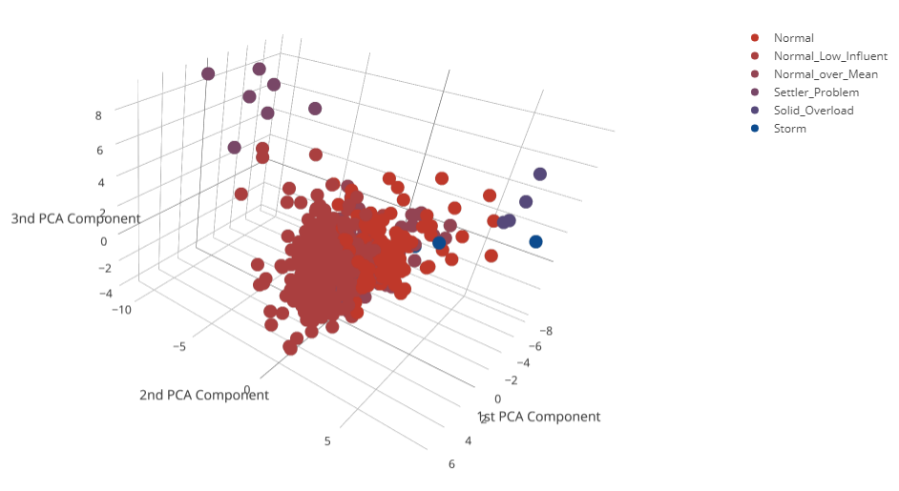
Principal Components Analysis

Slide 23
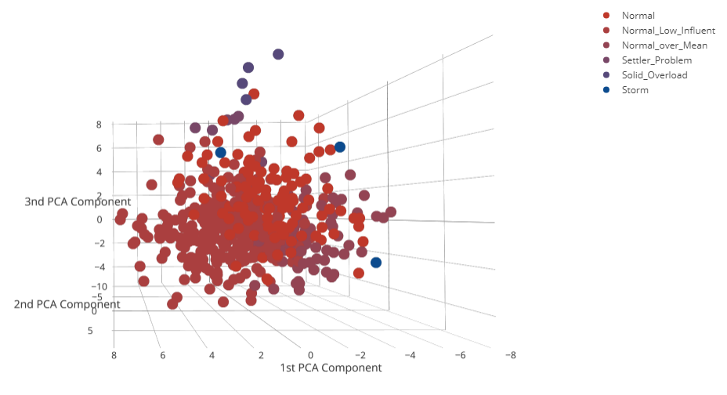
Principal Components Analysis

Slide 24
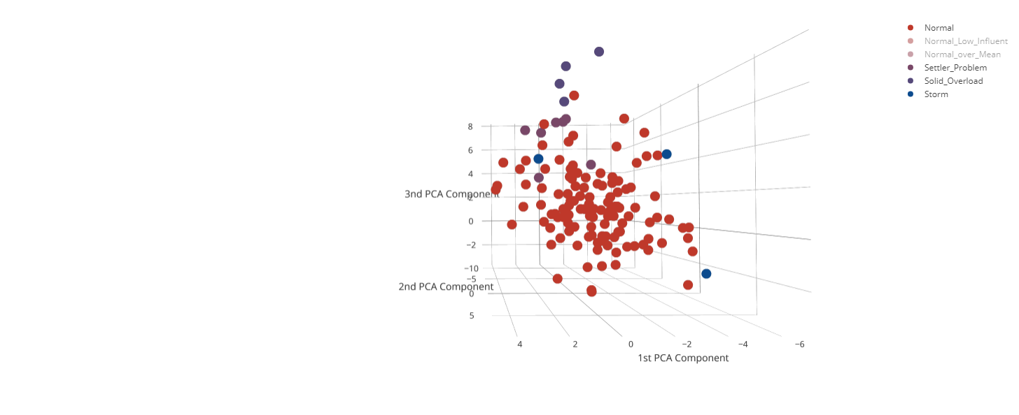
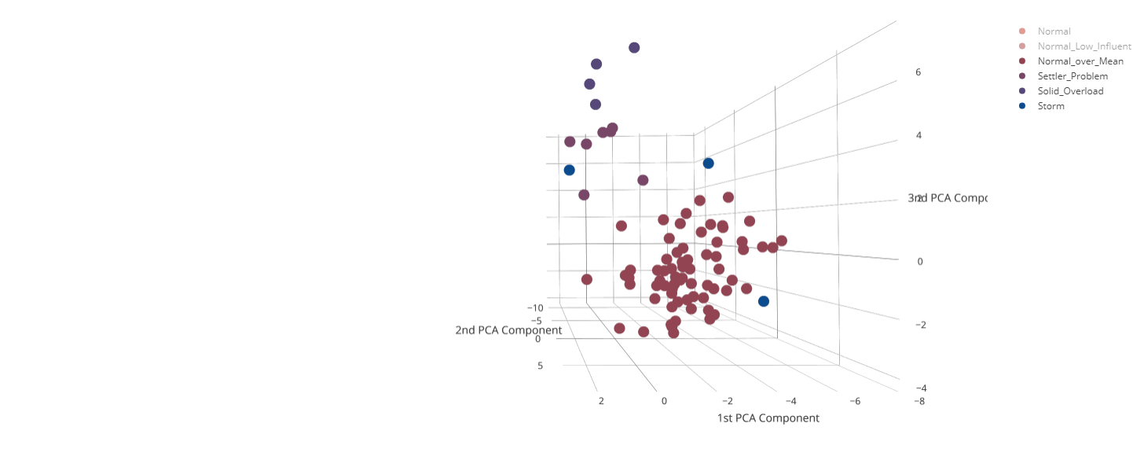
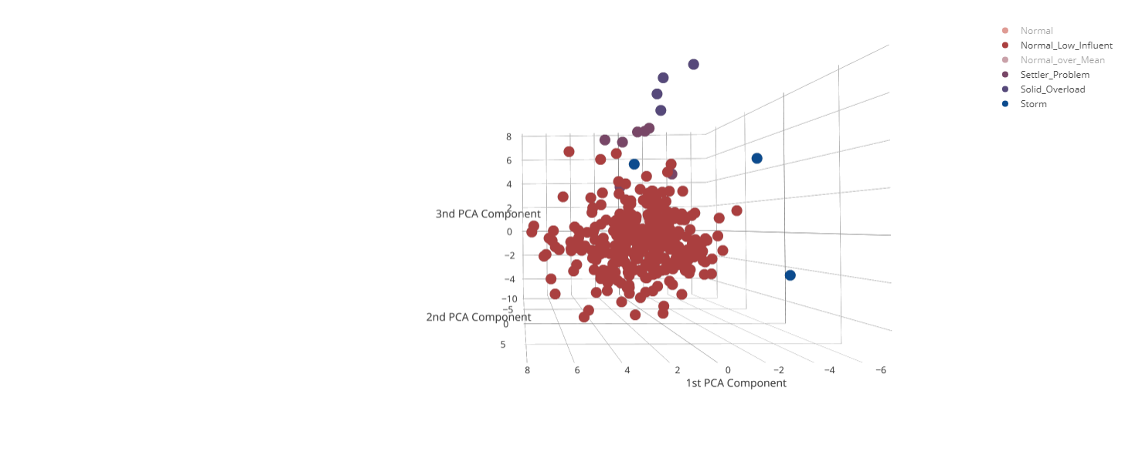
Principal Components Analysis

Slide 25
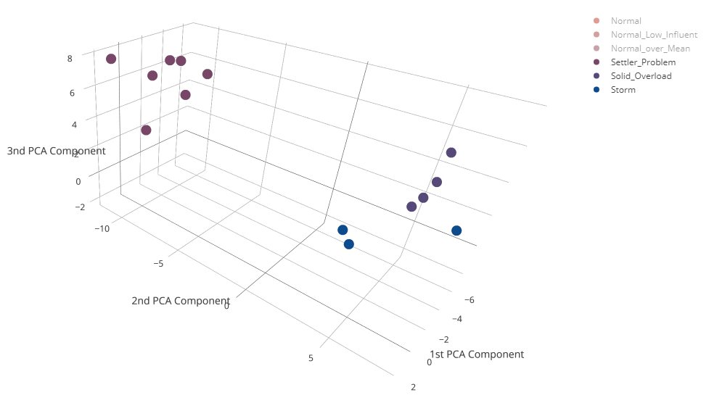
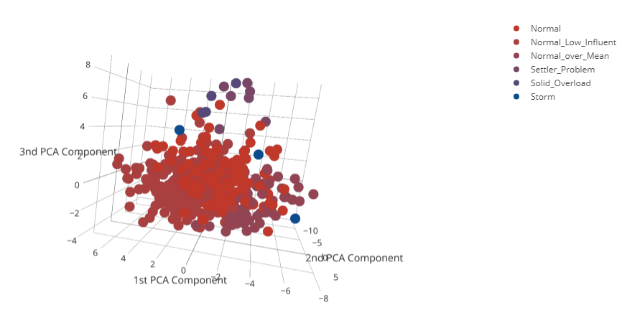
Principal Components Analysis

Slide 26
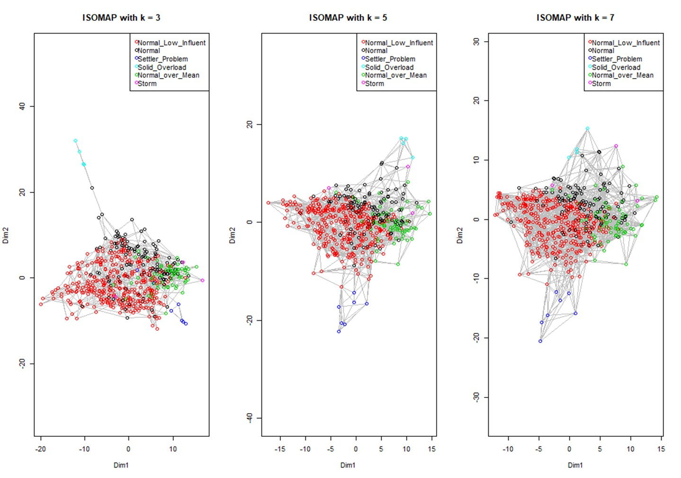
Isomap

Slide 27
LCMC
Dim | K= 5 | K= 6 | K= 7 | K= 8 | K= 9 | K= 10
2 | 0.0940 | 0.01068 | 0.1143 | 0.1173 | 0.1226 | 0.1284
3 | 0.1559 | 0.1717 | 0.1767 | 0.1864 | 0.1941 | 0.2037
4 | 0.2424 | 0.2703 | 0.2751 | 0.2898 | 0.2991 | 0.3145
5 | 0.3392 | 0.3592 | 0.3702 | 0.3806 | 0.3927 | 0.4031
6 | 0.4181 | 0.4348 | 0.4480 | 0.4617 | 0.4724 | 0.4773
7 | 0.5081 | 0.5300 | 0.5405 | 0.5485 | 0.5544 | 0.5604
PCA
Dim | K = 5 | K = 6 | K = 7 | K = 8 | K = 9 | K = 10
2 | 0.1157 | 0.1211 | 0.1325 | 0.1399 | 0.1454 | 0.1494
3 | 0.1157 | 0.1211 | 0.1325 | 0.1399 | 0.1454 | 0.1494
4 | 0.1157 | 0.1211 | 0.1325 | 0.1399 | 0.1454 | 0.1494
5 | 0.1157 | 0.1211 | 0.1325 | 0.1399 | 0.1454 | 0.1494
6 | 0.1157 | 0.1211 | 0.1325 | 0.1399 | 0.1454 | 0.1494
7 | 0.1157 | 0.1211 | 0.1325 | 0.1399 | 0.1454 | 0.1494
ISOMAP

Slide 28
Clustering
Data Set : n>>p (527x38)

Slide 29
Scale Data
Complete Linkage
Single Linkage
Average Linkage
Internal | Score | Clusters
Connectivity | 4.357 | 2
Dunn | 0.675 | 2
Silhouette | 0.745 | 2
Internal | Score | Clusters
Connectivity | 3.429 | 2
Dunn | 0.675 | 3
Silhouette | 0.741 | 3
Internal | Score | Clusters
Connectivity | 4.357 | 2
Dunn | 0.675 | 2
Silhouette | 0.745 | 2
Stability | Score | Clusters
APN | 0.0001 | 3
AD | 6.810 | 6
ADM | 0.002 | 3
FOM | 0.868 | 6
Stability | Score | Clusters
APN | 0.000 | 3
AD | 6.810 | 6
ADM | 0.000 | 3
FOM | 0.864 | 6
Stability | Score | Clusters
APN | 0.0001 | 6
AD | 6.810 | 6
ADM | 0.002 | 2
FOM | 0.865 | 6

Slide 30
Scale Data with Bound
Complete Linkage
Single Linkage
Average Linkage
Internal | Score | Clusters
Connectivity | 17.235 | 2
Dunn | 0.230 | 2
Silhouette | 0.421 | 2
Internal | Score | Clusters
Connectivity | 3.240 | 2
Dunn | 0.465 | 5
Silhouette | 0.471 | 2
Internal | Score | Clusters
Connectivity | 9.381 | 2
Dunn | 0.465 | 3
Silhouette | 0.488 | 2
Stability | Score | Clusters
APN | 0.0019 | 3
AD | 6.5057 | 6
ADM | 0.0178 | 2
FOM | 0.7924 | 6
Stability | Score | Clusters
APN | 0.000 | 3
AD | 6.504 | 8
ADM | 0.000 | 8
FOM | 0.798 | 8
Stability | Score | Clusters
APN | 0.0009 | 2
AD | 6.5057 | 6
ADM | 0.0183 | 2
FOM | 0.796 | 6

Slide 31
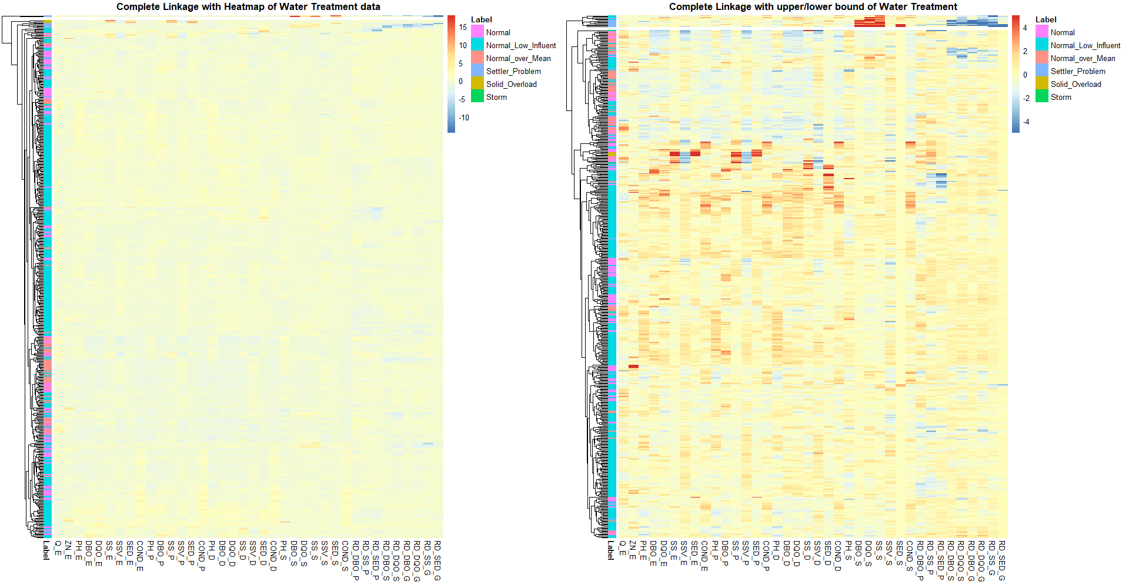
Data & Bounded-Raw Data with Complete Linkage

Slide 32
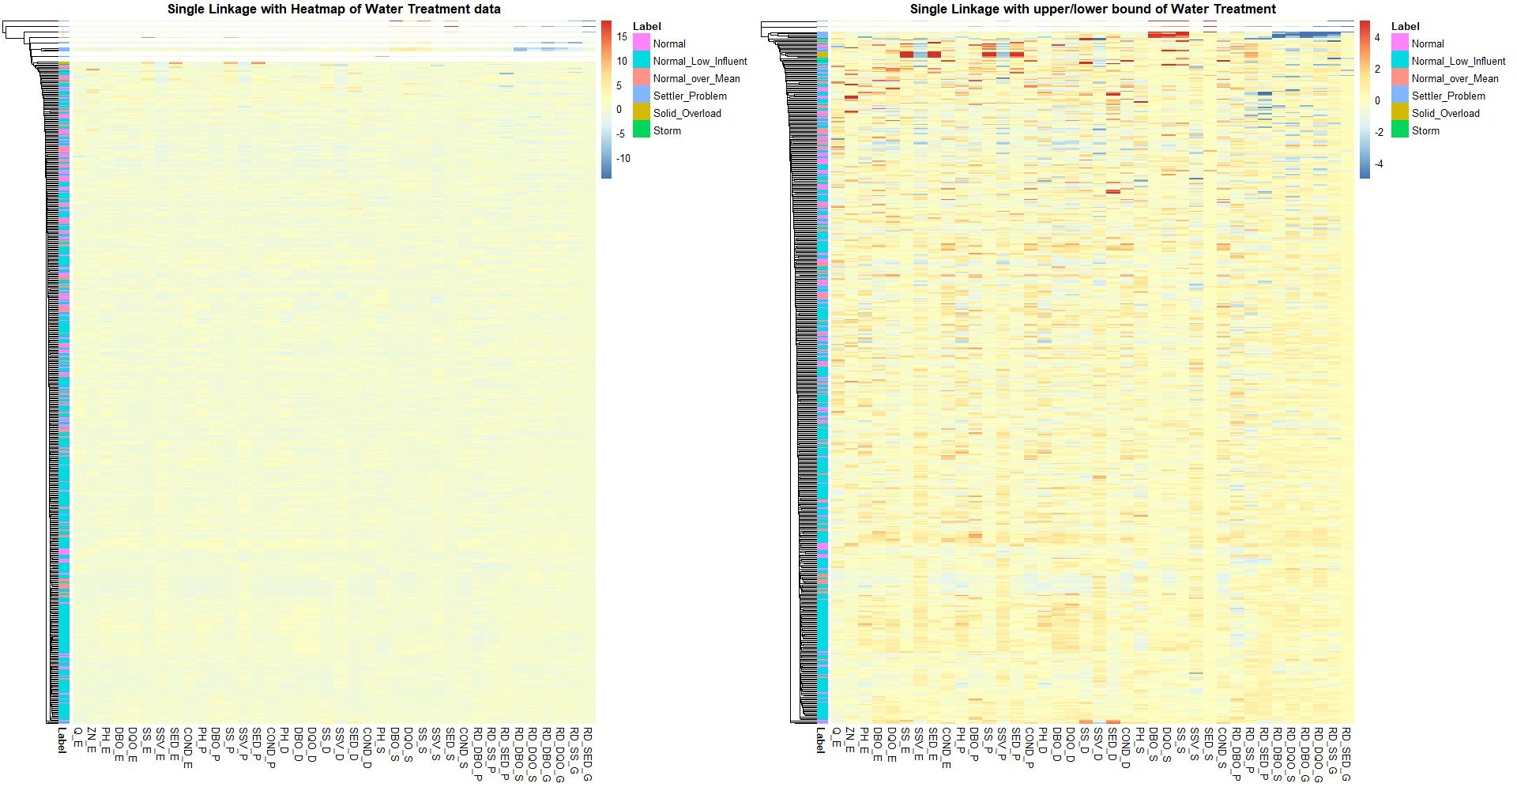
Data & Bounded-Raw Data with Single Linkage

Slide 33
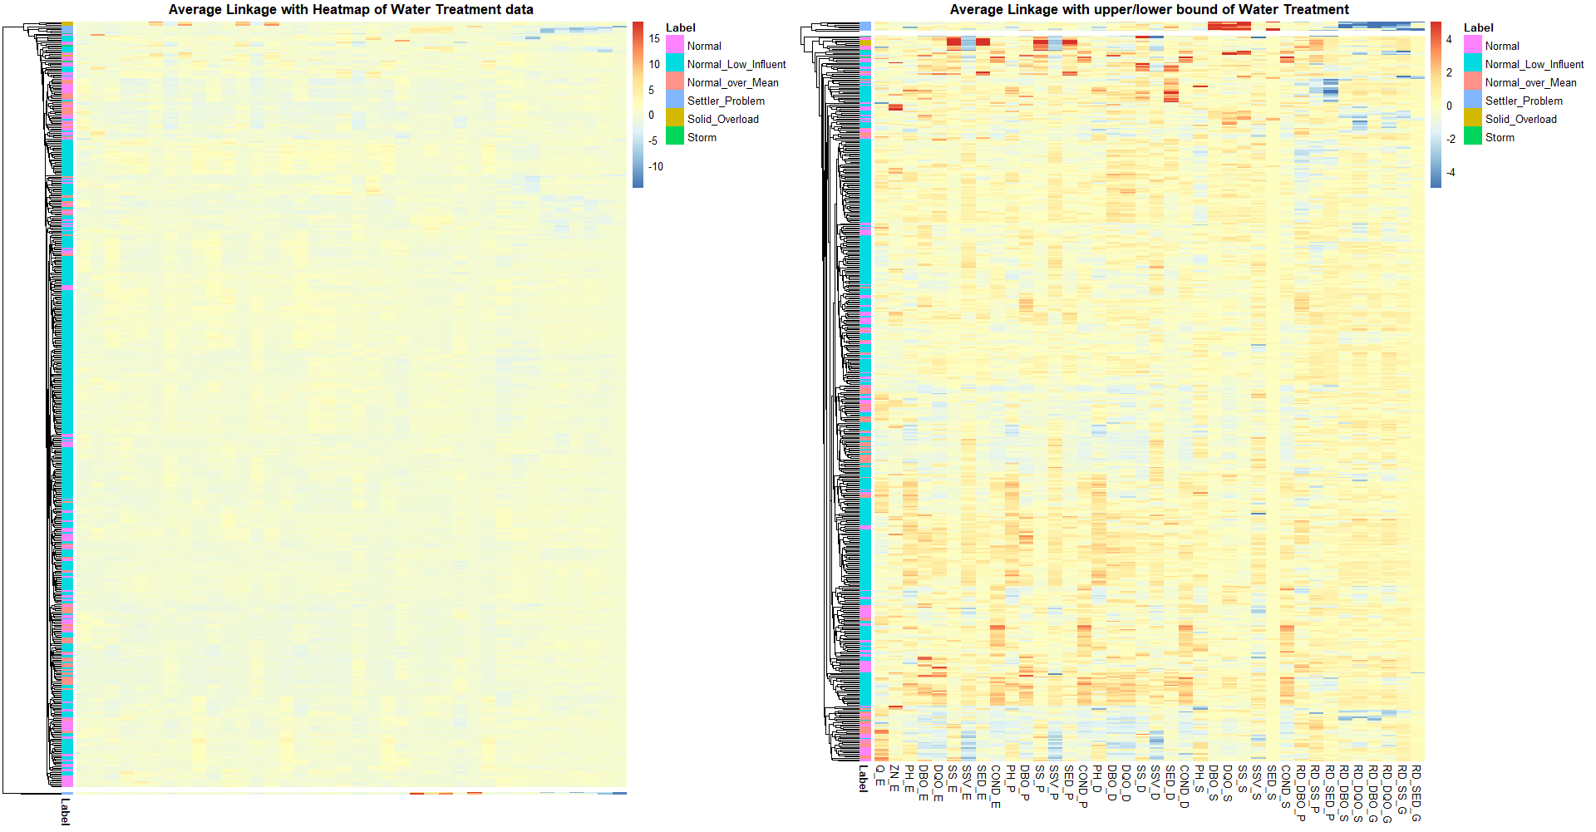
Data & Bounded-Raw Data with Average Linkage

Slide 34
Dimension Reduction
Data Set : n=p (38x38)

Slide 35
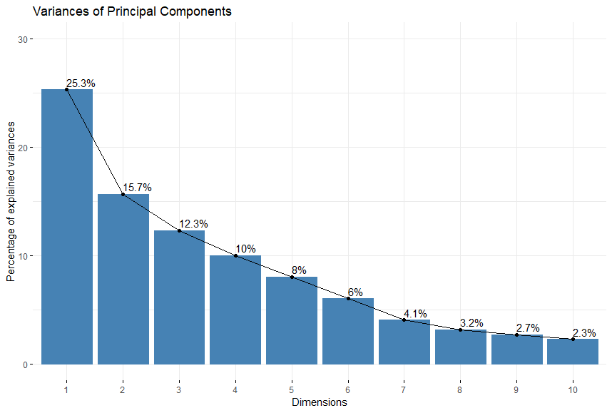
Principal Components Analysis

Slide 36
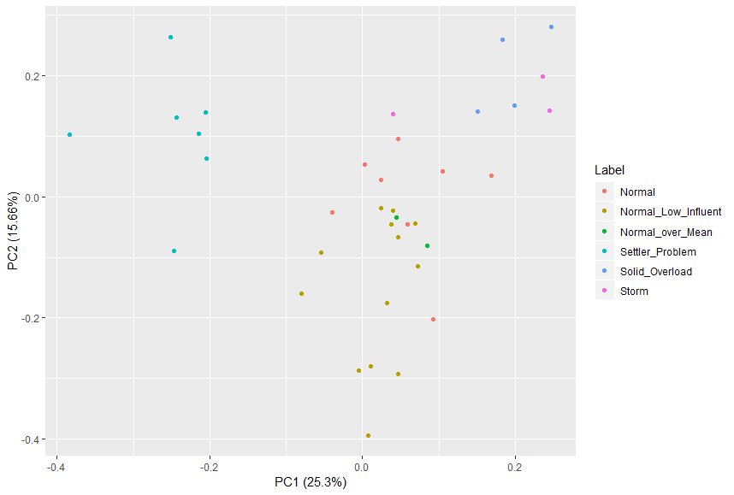
Principal Components Analysis

Slide 37
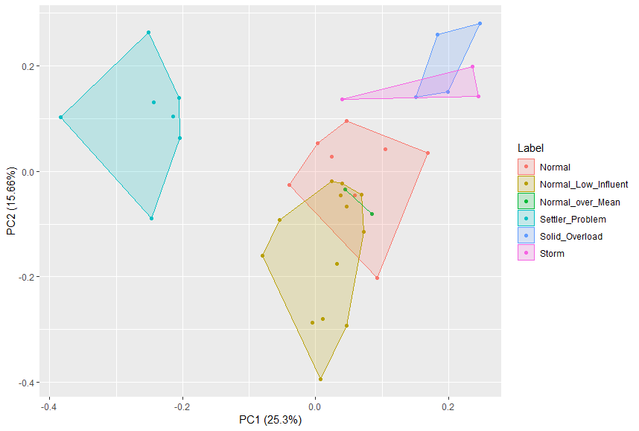
Principal Components Analysis

Slide 38
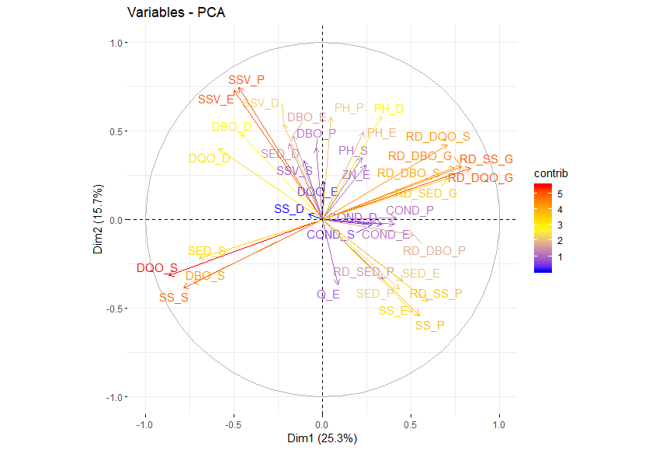
Principal Components Analysis

Slide 39
Principal Components Analysis
懸浮固體
較多
有機
汙染物
較少

Slide 40
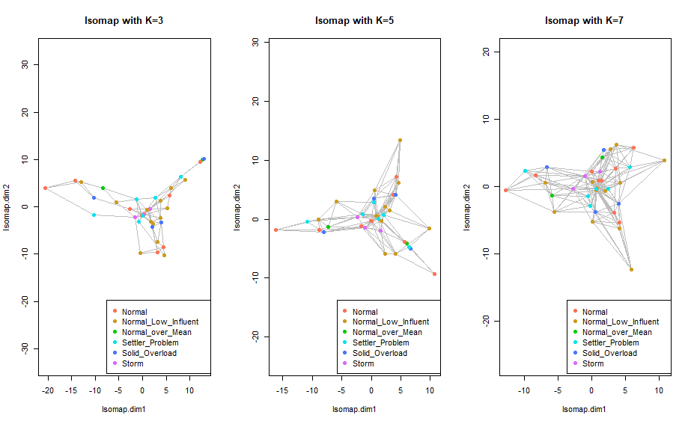
Isomap

Slide 41
LCMC
Dim | K= 5 | K= 6 | K= 7 | K= 8 | K= 9 | K= 10
2 | 0.3649 | 0.3861 | 0.3672 | 0.3660 | 0.3825 | 0.4034
3 | 0.4333 | 0.4343 | 0.4424 | 0.4548 | 0.4673 | 0.4666
4 | 0.5017 | 0.5308 | 0.5289 | 0.5469 | 0.5316 | 0.5113
5 | 0.5385 | 0.5615 | 0.5965 | 0.6029 | 0.5609 | 0.5692
6 | 0.6175 | 0.5966 | 0.6191 | 0.6226 | 0.5989 | 0.5982
7 | 0.6385 | 0.6361 | 0.6454 | 0.6259 | 0.6281 | 0.6139
PCA
Dim | K = 5 | K = 6 | K = 7 | K = 8 | K = 9 | K = 10
2 | 0.3333 | 0.3247 | 0.3371 | 0.3594 | 0.3474 | 0.3482
3 | 0.4017 | 0.4168 | 0.4123 | 0.4252 | 0.4263 | 0.4113
4 | 0.4807 | 0.4826 | 0.4537 | 0.4614 | 0.4439 | 0.4297
5 | 0.5175 | 0.5089 | 0.4762 | 0.4844 | 0.4585 | 0.4429
6 | 0.5543 | 0.5352 | 0.5176 | 0.5108 | 0.4731 | 0.4508
7 | 0.5649 | 0.5396 | 0.5401 | 0.5173 | 0.4819 | 0.4692
ISOMAP

Slide 42
Clustering
Data Set : n=p (38x38)

Slide 43
Complete Linkage
Single Linkage
Average Linkage
Internal | Score | Clusters
Connectivity | 25.671 | 3
Dunn | 0.392 | 6
Silhouette | 0.157 | 6
Internal | Score | Clusters
Connectivity | 2.929 | 2
Dunn | 0.582 | 2
Silhouette | 0.299 | 2
Internal | Score | Clusters
Connectivity | 2.929 | 2
Dunn | 0.567 | 3
Silhouette | 0.301 | 2
Stability | Score | Clusters
APN | 0.075 | 6
AD | 5.391 | 6
ADM | 0.783 | 6
FOM | 0.729 | 6
Stability | Score | Clusters
APN | 0.005 | 4
AD | 5.998 | 6
ADM | 0.067 | 4
FOM | 0.873 | 6
Stability | Score | Clusters
APN | 0.006 | 3
AD | 5.861 | 6
ADM | 0.000 | 8
FOM | 0.871 | 6

Slide 44
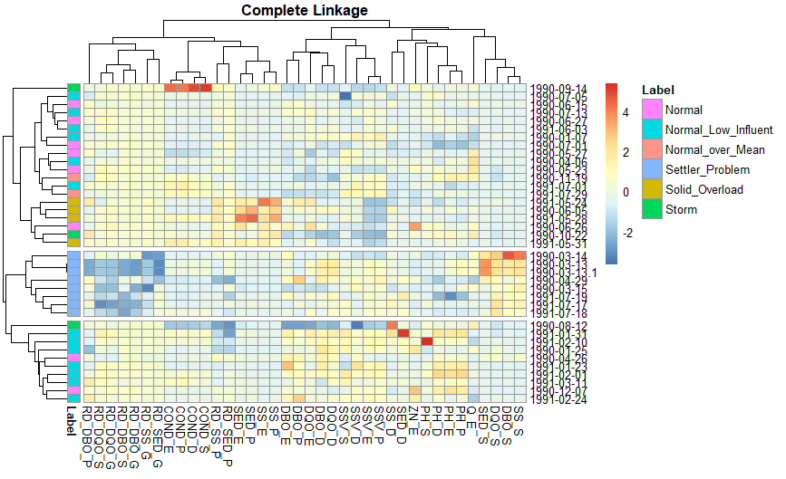
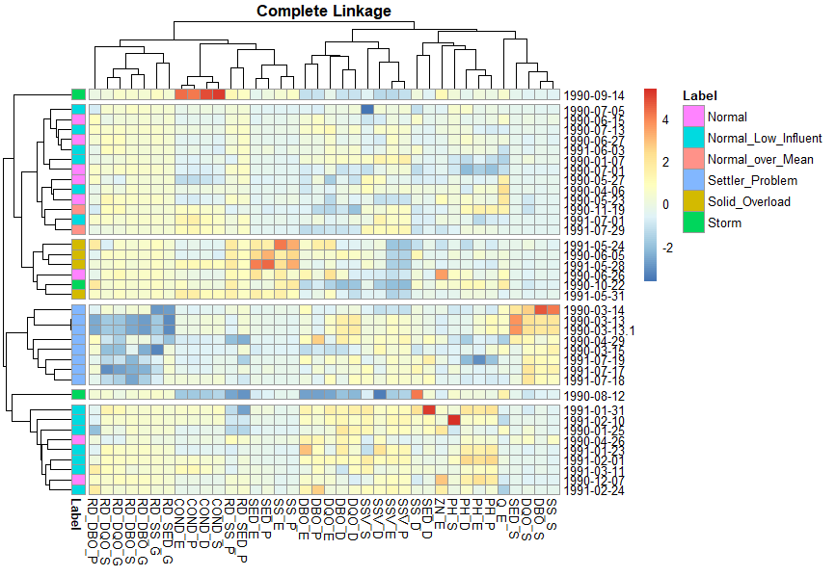

Slide 45
Complete Linkage
Single Linkage
Average Linkage
Internal | Score | Clusters
Connectivity | 25.671 | 3
Dunn | 0.392 | 6
Silhouette | 0.157 | 6
Internal | Score | Clusters
Connectivity | 2.929 | 2
Dunn | 0.582 | 2
Silhouette | 0.299 | 2
Internal | Score | Clusters
Connectivity | 2.929 | 2
Dunn | 0.567 | 3
Silhouette | 0.301 | 2
Stability | Score | Clusters
APN | 0.075 | 6
AD | 5.391 | 6
ADM | 0.783 | 6
FOM | 0.729 | 6
Stability | Score | Clusters
APN | 0.005 | 4
AD | 5.998 | 6
ADM | 0.067 | 4
FOM | 0.873 | 6
Stability | Score | Clusters
APN | 0.006 | 3
AD | 5.861 | 6
ADM | 0.000 | 8
FOM | 0.871 | 6

Slide 46
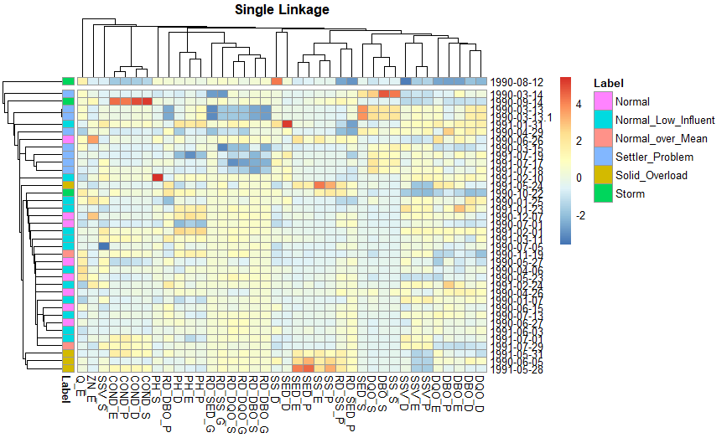

Slide 47
Complete Linkage
Single Linkage
Average Linkage
Internal | Score | Clusters
Connectivity | 25.671 | 3
Dunn | 0.392 | 6
Silhouette | 0.157 | 6
Internal | Score | Clusters
Connectivity | 2.929 | 2
Dunn | 0.582 | 2
Silhouette | 0.299 | 2
Internal | Score | Clusters
Connectivity | 2.929 | 2
Dunn | 0.567 | 3
Silhouette | 0.301 | 2
Stability | Score | Clusters
APN | 0.075 | 6
AD | 5.391 | 6
ADM | 0.783 | 6
FOM | 0.729 | 6
Stability | Score | Clusters
APN | 0.005 | 4
AD | 5.998 | 6
ADM | 0.067 | 4
FOM | 0.873 | 6
Stability | Score | Clusters
APN | 0.006 | 3
AD | 5.861 | 6
ADM | 0.000 | 8
FOM | 0.871 | 6

Slide 48
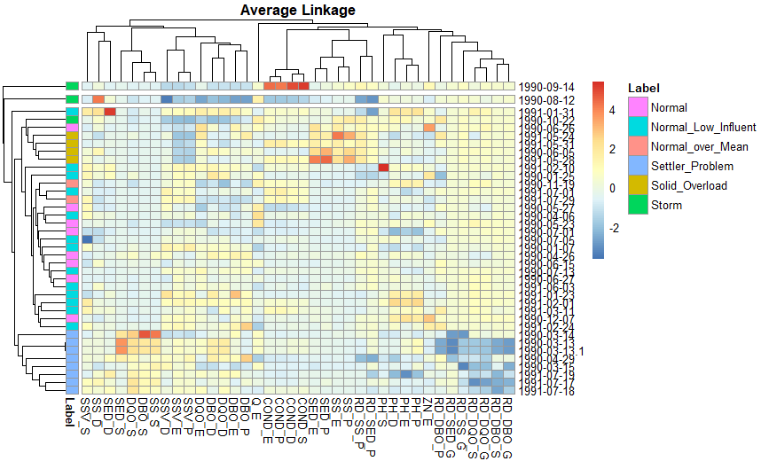

Slide 49
Dimension Reduction
Data Set : n<<p (20x38)

Slide 50
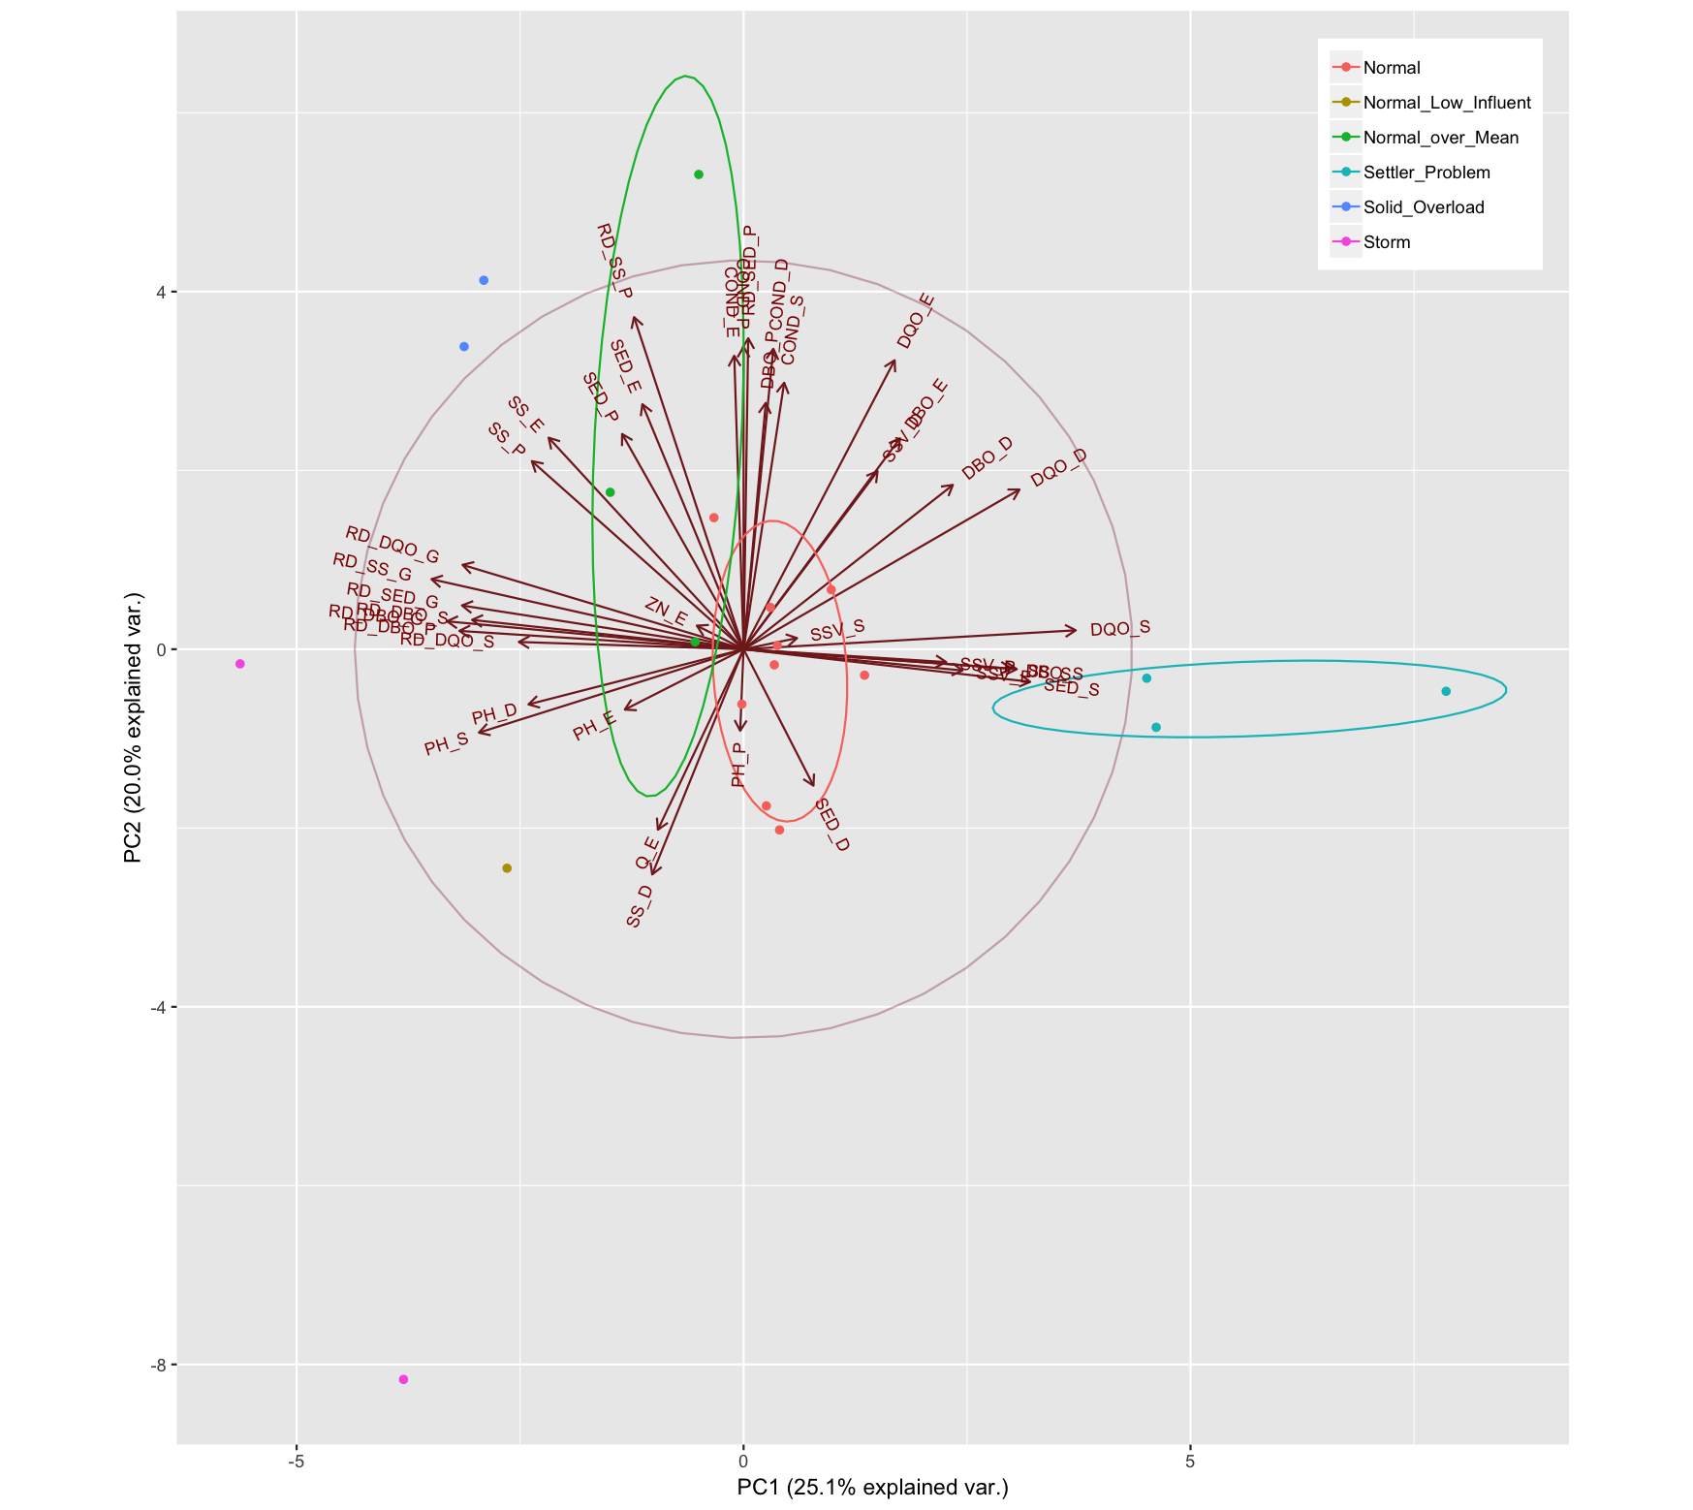
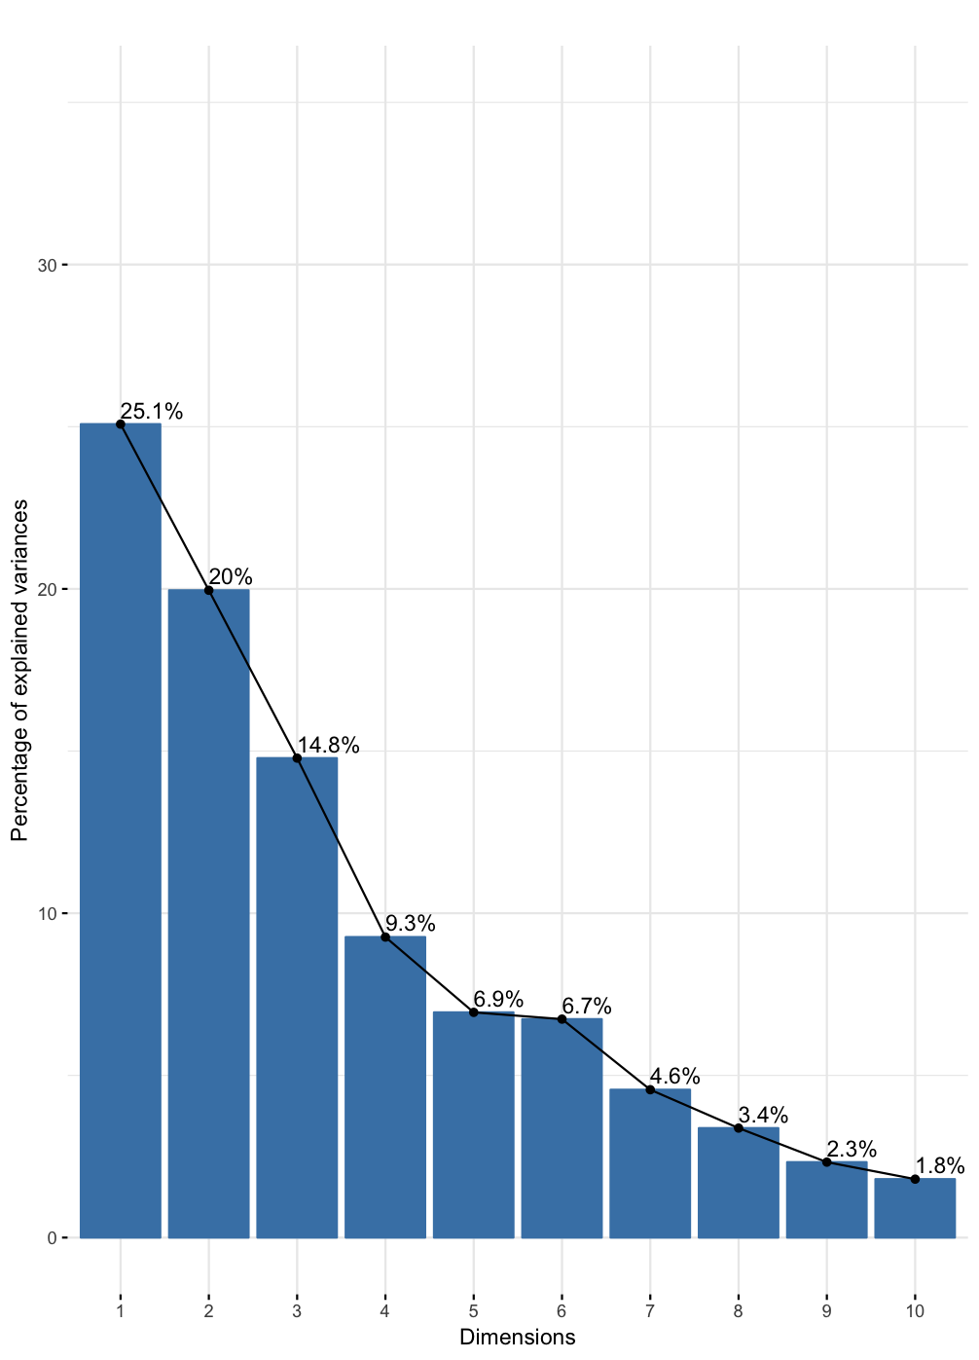
Principal Components Analysis

Slide 51
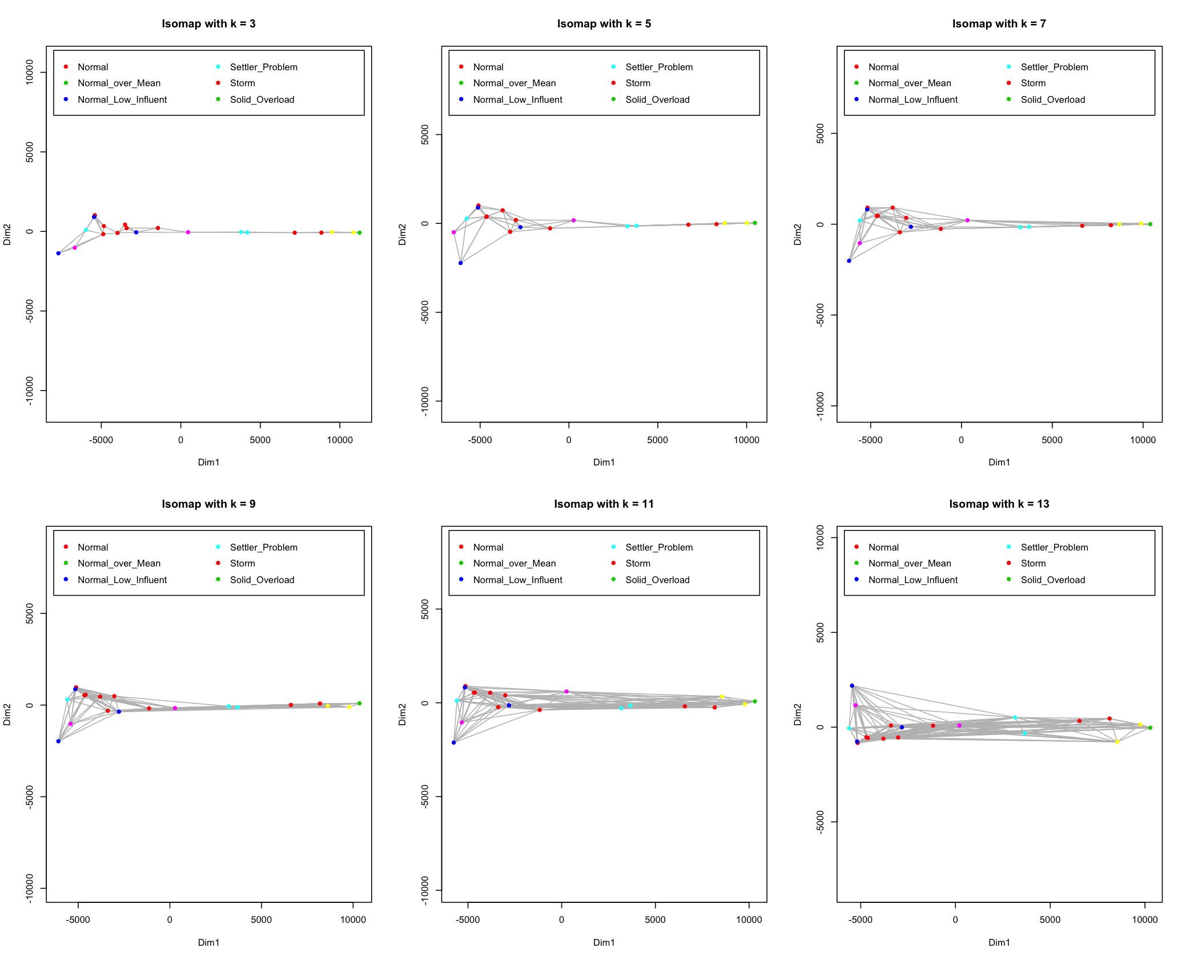
Isomap

Slide 52
LCMC
Dim | K = 5 | K = 6 | K = 7 | K = 8 | K = 9 | K = 10
2 | 0.0468 | 0.0509 | 0.0602 | 0.0727 | 0.0819 | 0.0837
3 | 0.0568 | 0.0509 | 0.0387 | 0.0539 | 0.0874 | 0.0787
4 | 0.0568 | 0.0509 | 0.0459 | 0.0664 | 0.0819 | 0.0737
5 | 0.0368 | 0.0509 | 0.0673 | 0.0789 | 0.0985 | 0.0887
6 | 0.0868 | 0.0592 | 0.0673 | 0.0852 | 0.1263 | 0.1037
7 | 0.0968 | 0.0925 | 0.0816 | 0.0852 | 0.1319 | 0.1087
PCA
Dim | K = 5 | K = 6 | K = 7 | K = 8 | K = 9 | K = 10
2 | 0.7068 | 0.6592 | 0.5959 | 0.5602 | 0.4985 | 0.4587
3 | 0.7068 | 0.6425 | 0.5959 | 0.5477 | 0.4985 | 0.4587
4 | 0.7068 | 0.6509 | 0.5959 | 0.5477 | 0.4985 | 0.4587
5 | 0.7068 | 0.6425 | 0.5816 | 0.5414 | 0.4985 | 0.4587
6 | 0.7068 | 0.6425 | 0.5887 | 0.5414 | 0.4985 | 0.4587
7 | 0.6968 | 0.6425 | 0.5887 | 0.5414 | 0.4985 | 0.4587
ISOMAP

Slide 53
Clustering
Data Set : n<<p (20x38)

Slide 54
Complete Linkage
Single Linkage
Internal | Score | Clusters
Connectivity | 11.639 | 3
Dunn | 0.527 | 6
Silhouette | 0.606 | 3
Internal | Score | Clusters
Connectivity | 8.836 | 3
Dunn | 0.478 | 3
Silhouette | 0.614 | 3
Stability | Score | Clusters
APN | 0.006 | 3
AD | 744.48 | 8
ADM | 92.221 | 8
FOM | 204.65 | 8
Stability | Score | Clusters
APN | 0.005 | 3
AD | 1086.5 | 8
ADM | 79.275 | 8
FOM | 211.33 | 8

Slide 55
Average Linkage
Ward’s Linkage
Internal | Score | Clusters
Connectivity | 11.64 | 3
Dunn | 0.527 | 6
Silhouette | 0.606 | 3
Internal | Score | Clusters
Connectivity | 8.836 | 3
Dunn | 0.478 | 3
Silhouette | 0.614 | 3
Stability | Score | Clusters
APN | 0.008 | 4
AD | 914.61 | 8
ADM | 93.932 | 7
FOM | 199.92 | 7
Stability | Score | Clusters
APN | 0.014 | 7
AD | 746.86 | 8
ADM | 97.1 | 8
FOM | 205.4 | 8

Slide 56
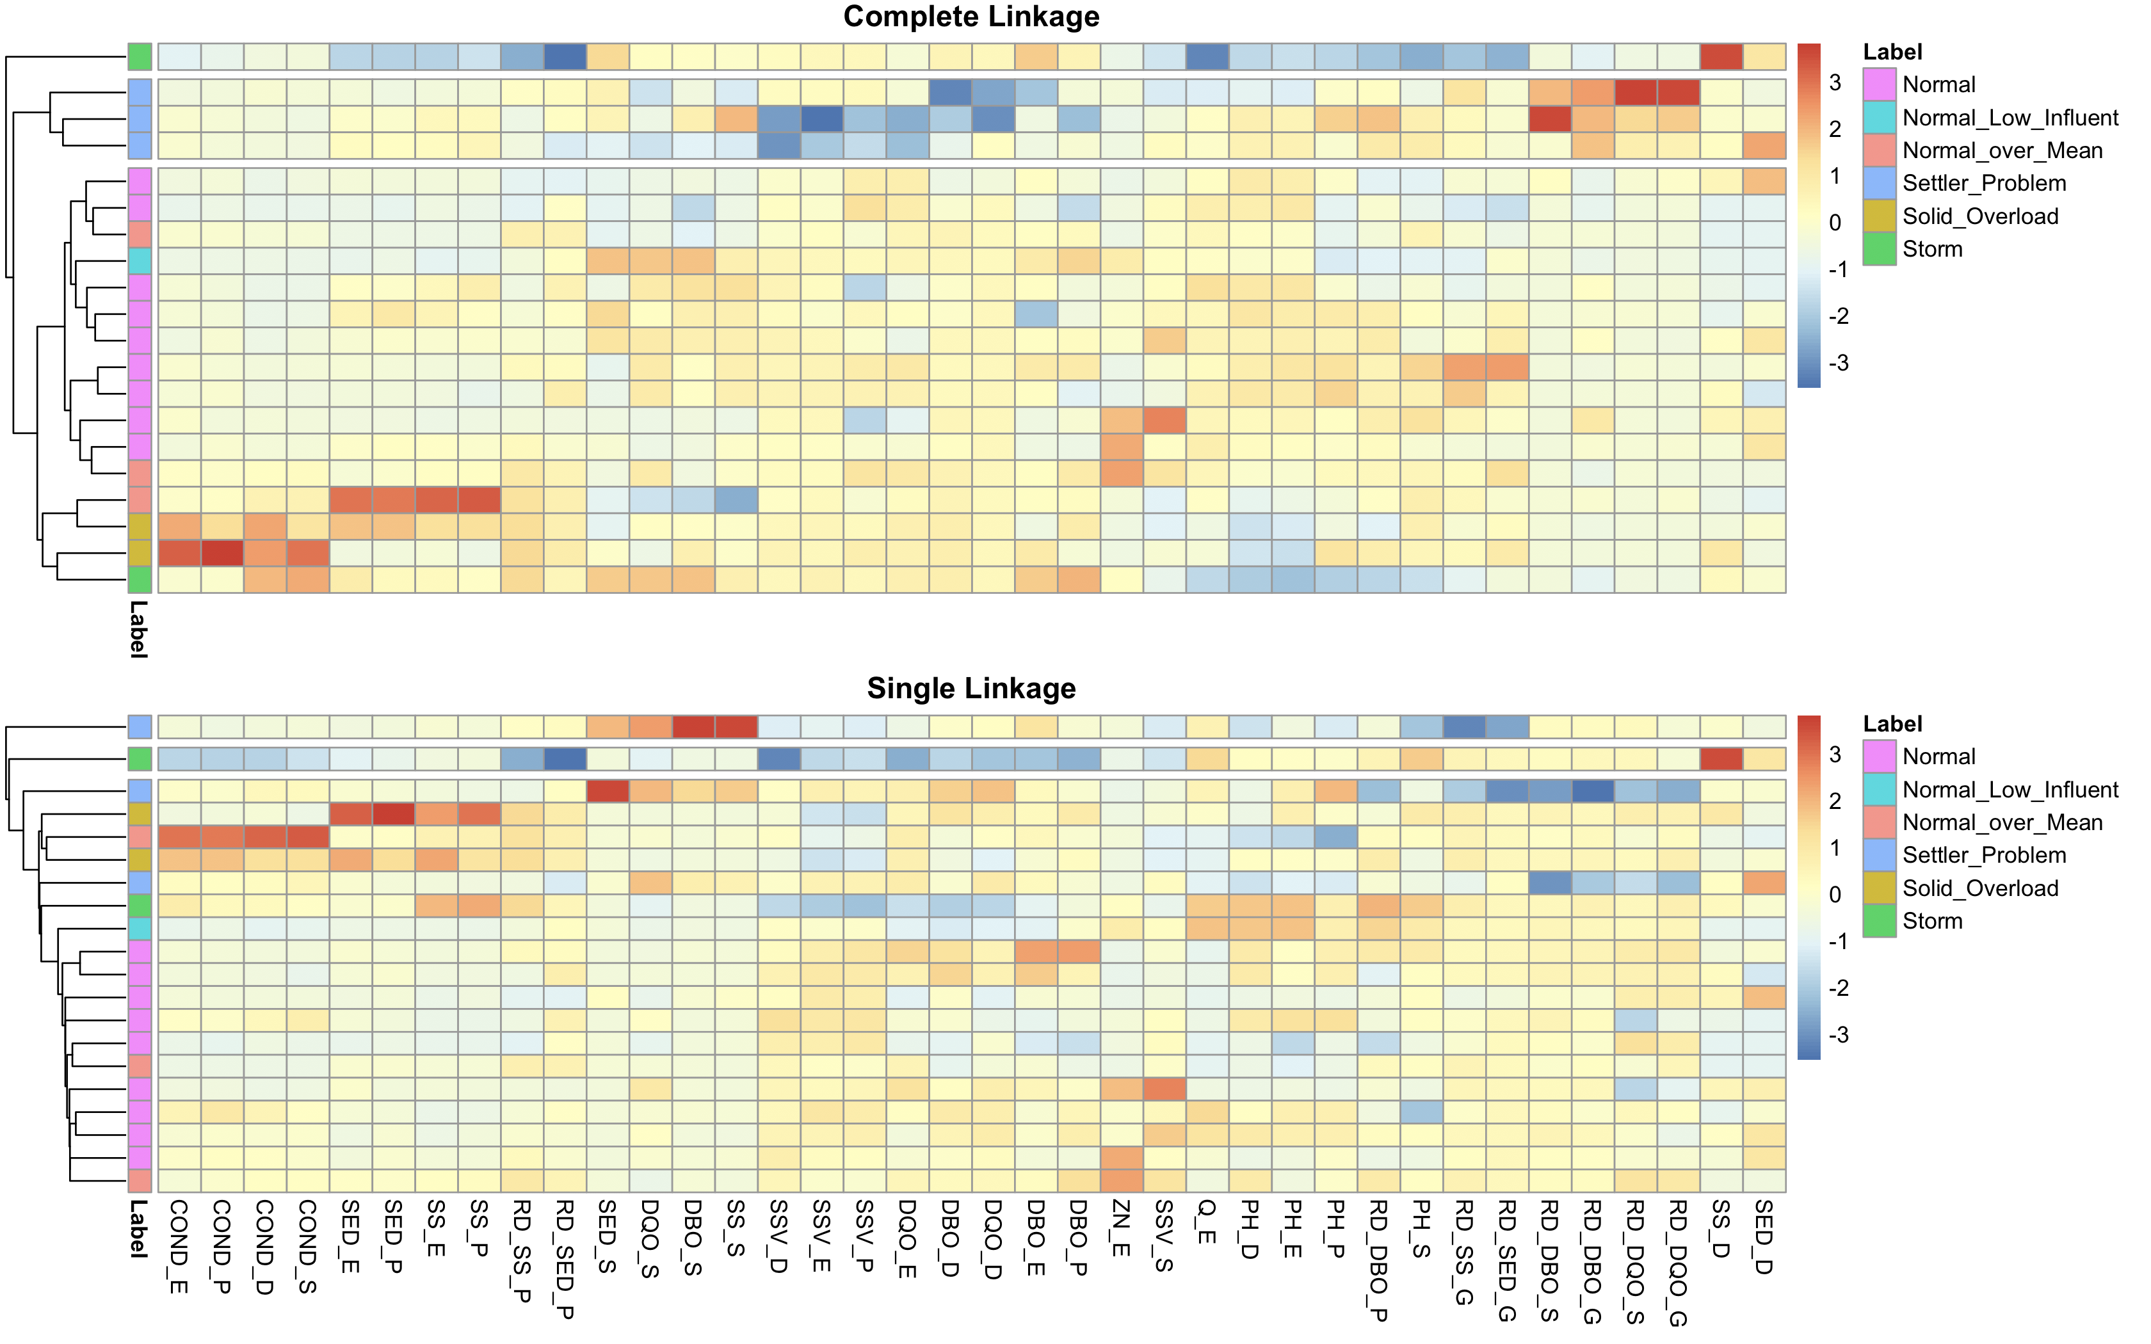

Slide 57
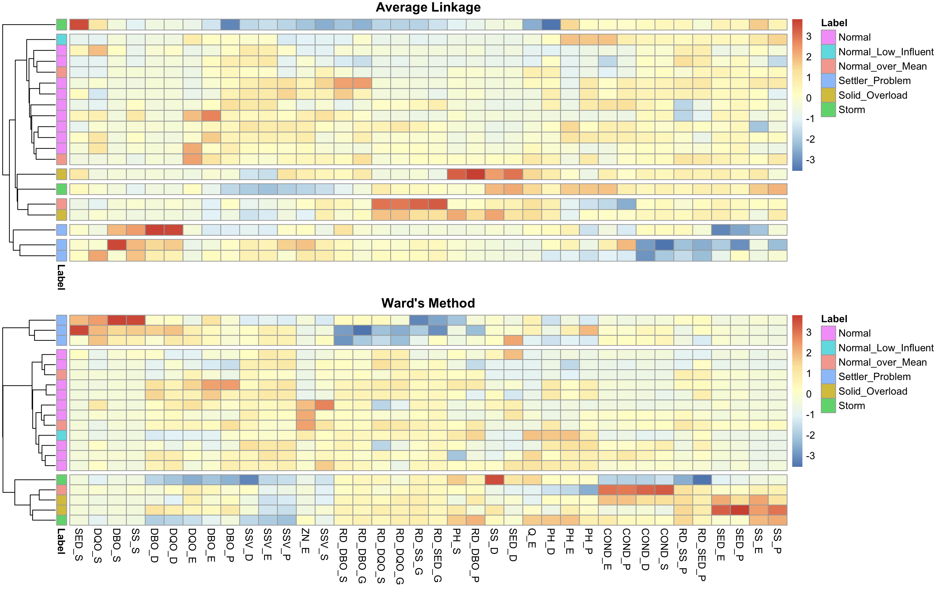

Slide 58
Conclusion

Slide 59
方法選擇
限制
未來展望
PCA
汙水處理領域
極端值
資料處理方向

Slide 60
Reference
UCI Machine Learning Repository: Wastewater Treatment Plant Data Set
https://archive.ics.uci.edu/ml/datasets/water+treatment+plant
Primary, Secondary, and Tertiary Wastewater Treatment: How Do They Work?
Organica
https://www.organicawater.com/primary-secondary-tertiary-wastewater-treatment-work/
Wastewater Treatment Processes
(Sep 12th-15th, 2016) by Dr. Arun Kumar
An Insight over Water Treatment Plans Dataset
using Machine Learning EDA
https://medium.com/greyatom/an-insight-over-water-treatment-plans-dataset-using-machine-learning-eda-48bfaee22016
Applying Machine Learning Methods to Wastewater Treatment Plant Data
Joaquim Comas, Saso Dzeroski and Miquel Sanchez-Marre

Slide 61
附錄 I
使用R套件及其指令
資料整理
tidyverse(dplyr, purrr) | mutate( ), arrange( ), filter( ), map( ), reduce( ), %>% …
class | knn( )
探索式資料分析
tidyverse(ggplot2) | geom_density( ), geom_boxplot( ), geom_tile( ), facet_wrap( )
GGally | ggparcoord( )
gridExtra | grid.arrange( )
遺失值
VIM | aggr( ), matrixplot( ), kNN( )
mice | mice( )
資料轉換
timeDate(fBasics) | Skewness( )
維度縮減
factoextra | fviz_eig( )
FactoMineR | PCA( )
plotly | plot_ly( )
ggbiplot | ggbiplot( )
vegan | isomap( )
coRanking | coranking( ), LCMC( )
群集分析
pheatmap | pheatmap( )
clValid | clValid( )

Slide 62
附錄 II
組內工作分配及期望成績
藍雍淵 | 劉又瑄 | 蔡岱融
整理Raw Data 處理資料轉換 分析 Data set n>>p 影片製作 | 整理資料背景 分析 Data set n=p 資料彙整 PPT製作 | 整理Raw Data 探索式資料分析 處理Missing Values 分析Data set n<<p
期望分數:90分 | 期望分數:90分 | 期望分數:90分

